Slide 1
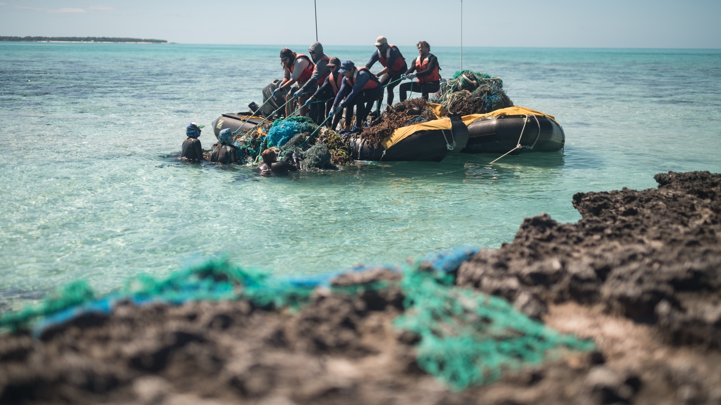
Northwestern Hawaiian Islands Marine Debris Project
James Morioka
Operations Manager
Joint Institute for Marine and Atmospheric Research (JIMAR)
NOAA Pacific Islands Fisheries Science Center (PIFSC) Ecosystem Sciences Division (ESD)

Slide 2
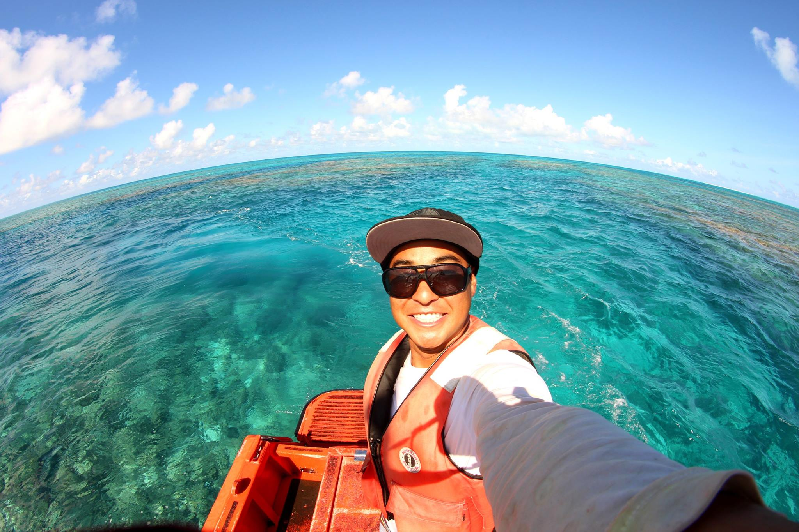
About the Presenter
James Morioka
Operations Manager
Joint Institute for Marine and Atmospheric Research (JIMAR)
NOAA Pacific Islands Fisheries Science Center (PIFSC) Ecosystem Sciences Division (ESD)
james.morioka@noaa.gov
808-725-5491

Slide 3
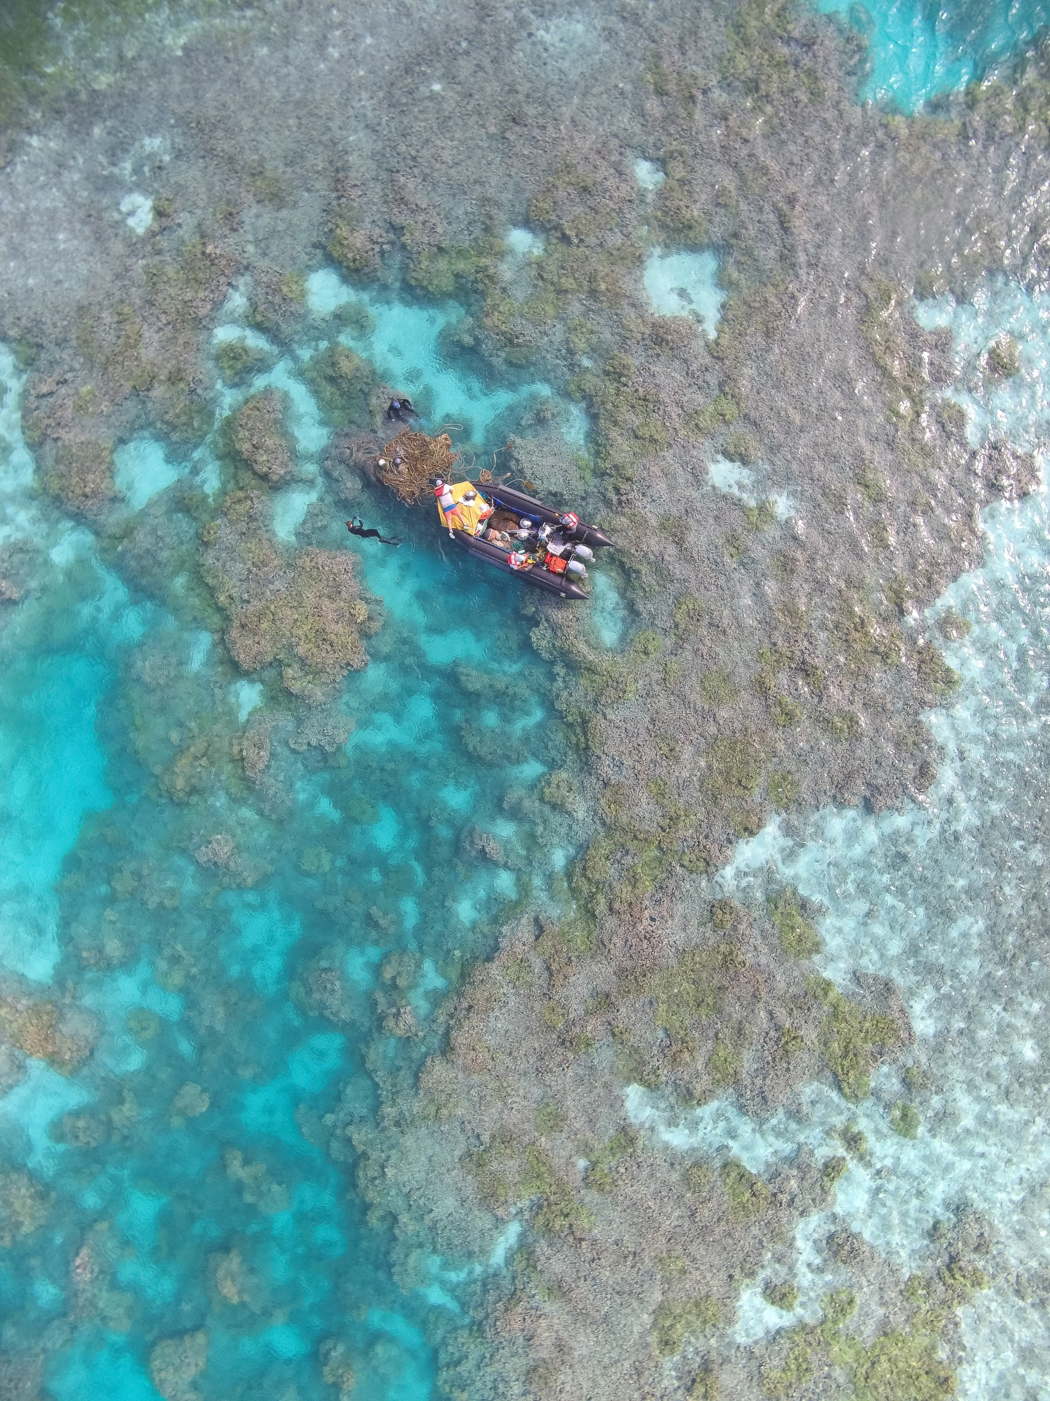
Presentation Overview
Background Information on the Hawaiian Islands and Marine Debris
Project History
Survey and Removal Methods
2018 Field Mission
Research
Future
Questions

Slide 4
Project Partners
NOAA Pacific Islands Fisheries Science Center (PIFSC)
Joint Institute for Marine and Atmospheric Research (JIMAR)
NOAA Marine Debris Program (MDP)
NOAA Damage Assessment Remediation and Restoration Program (DARRP)
National Fish and Wildlife Foundation (NFWF)
Fishing for Energy – Schnitzer Steel Co. and H-Power/Covanta Energy
University of Hawaii
NOAA Papahānaumokuākea Marine National Monument Program (PMNM)
U.S. Fish and Wildlife Services (USFWS)
National Marine Sanctuaries Foundation (NMSF)
Satlink Global
Co-trustees of the Papahānaumokuākea Marine National Monument

Slide 5
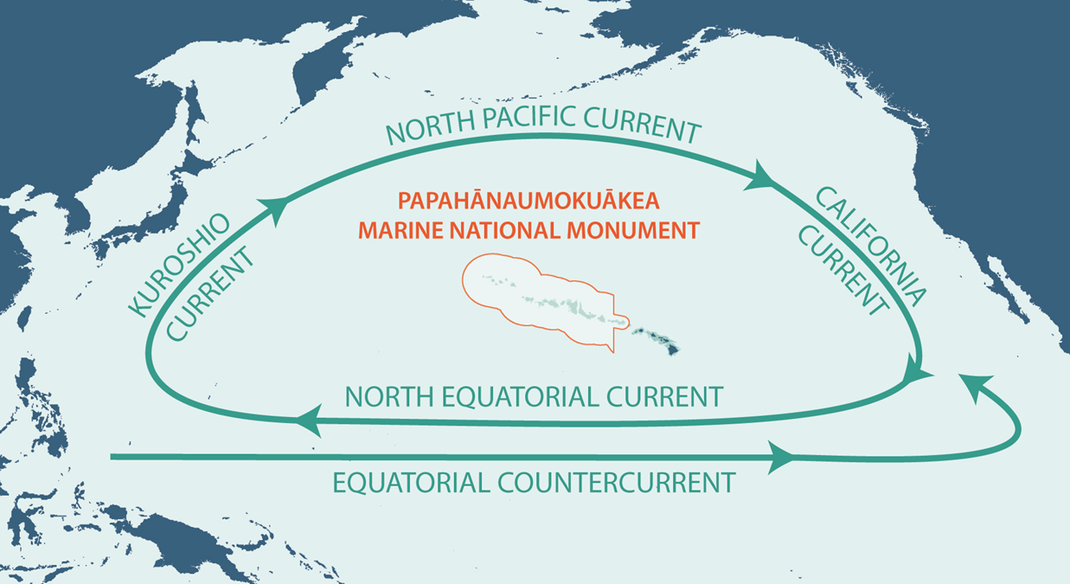
Background Information
Hawaiian archipelago centrally located in N. Pacific Gyre
Northwestern Hawaiian Islands (NWHI) -uninhabited islands and atolls
70% of shallow water coral reef habitats in U.S.
More than 7,000 marine species (25% endemic)

Slide 6
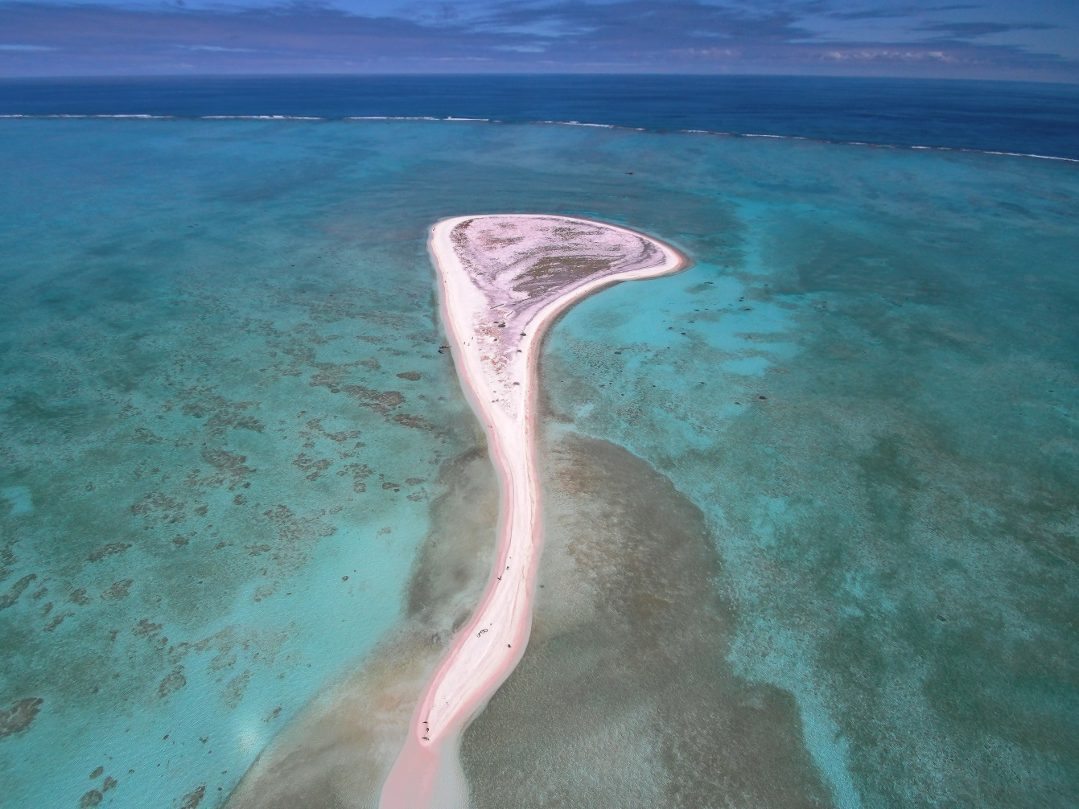
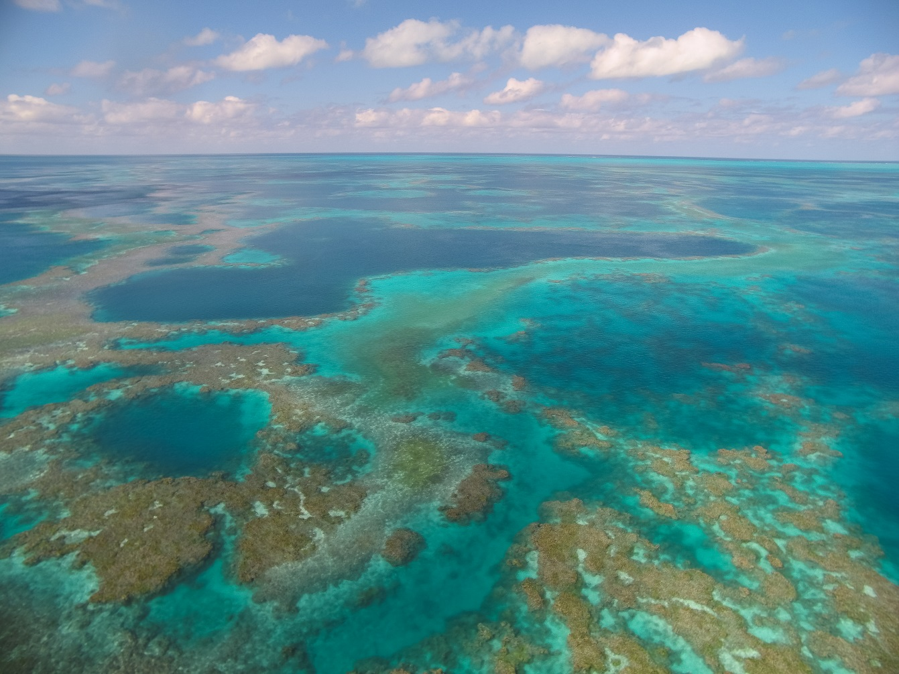
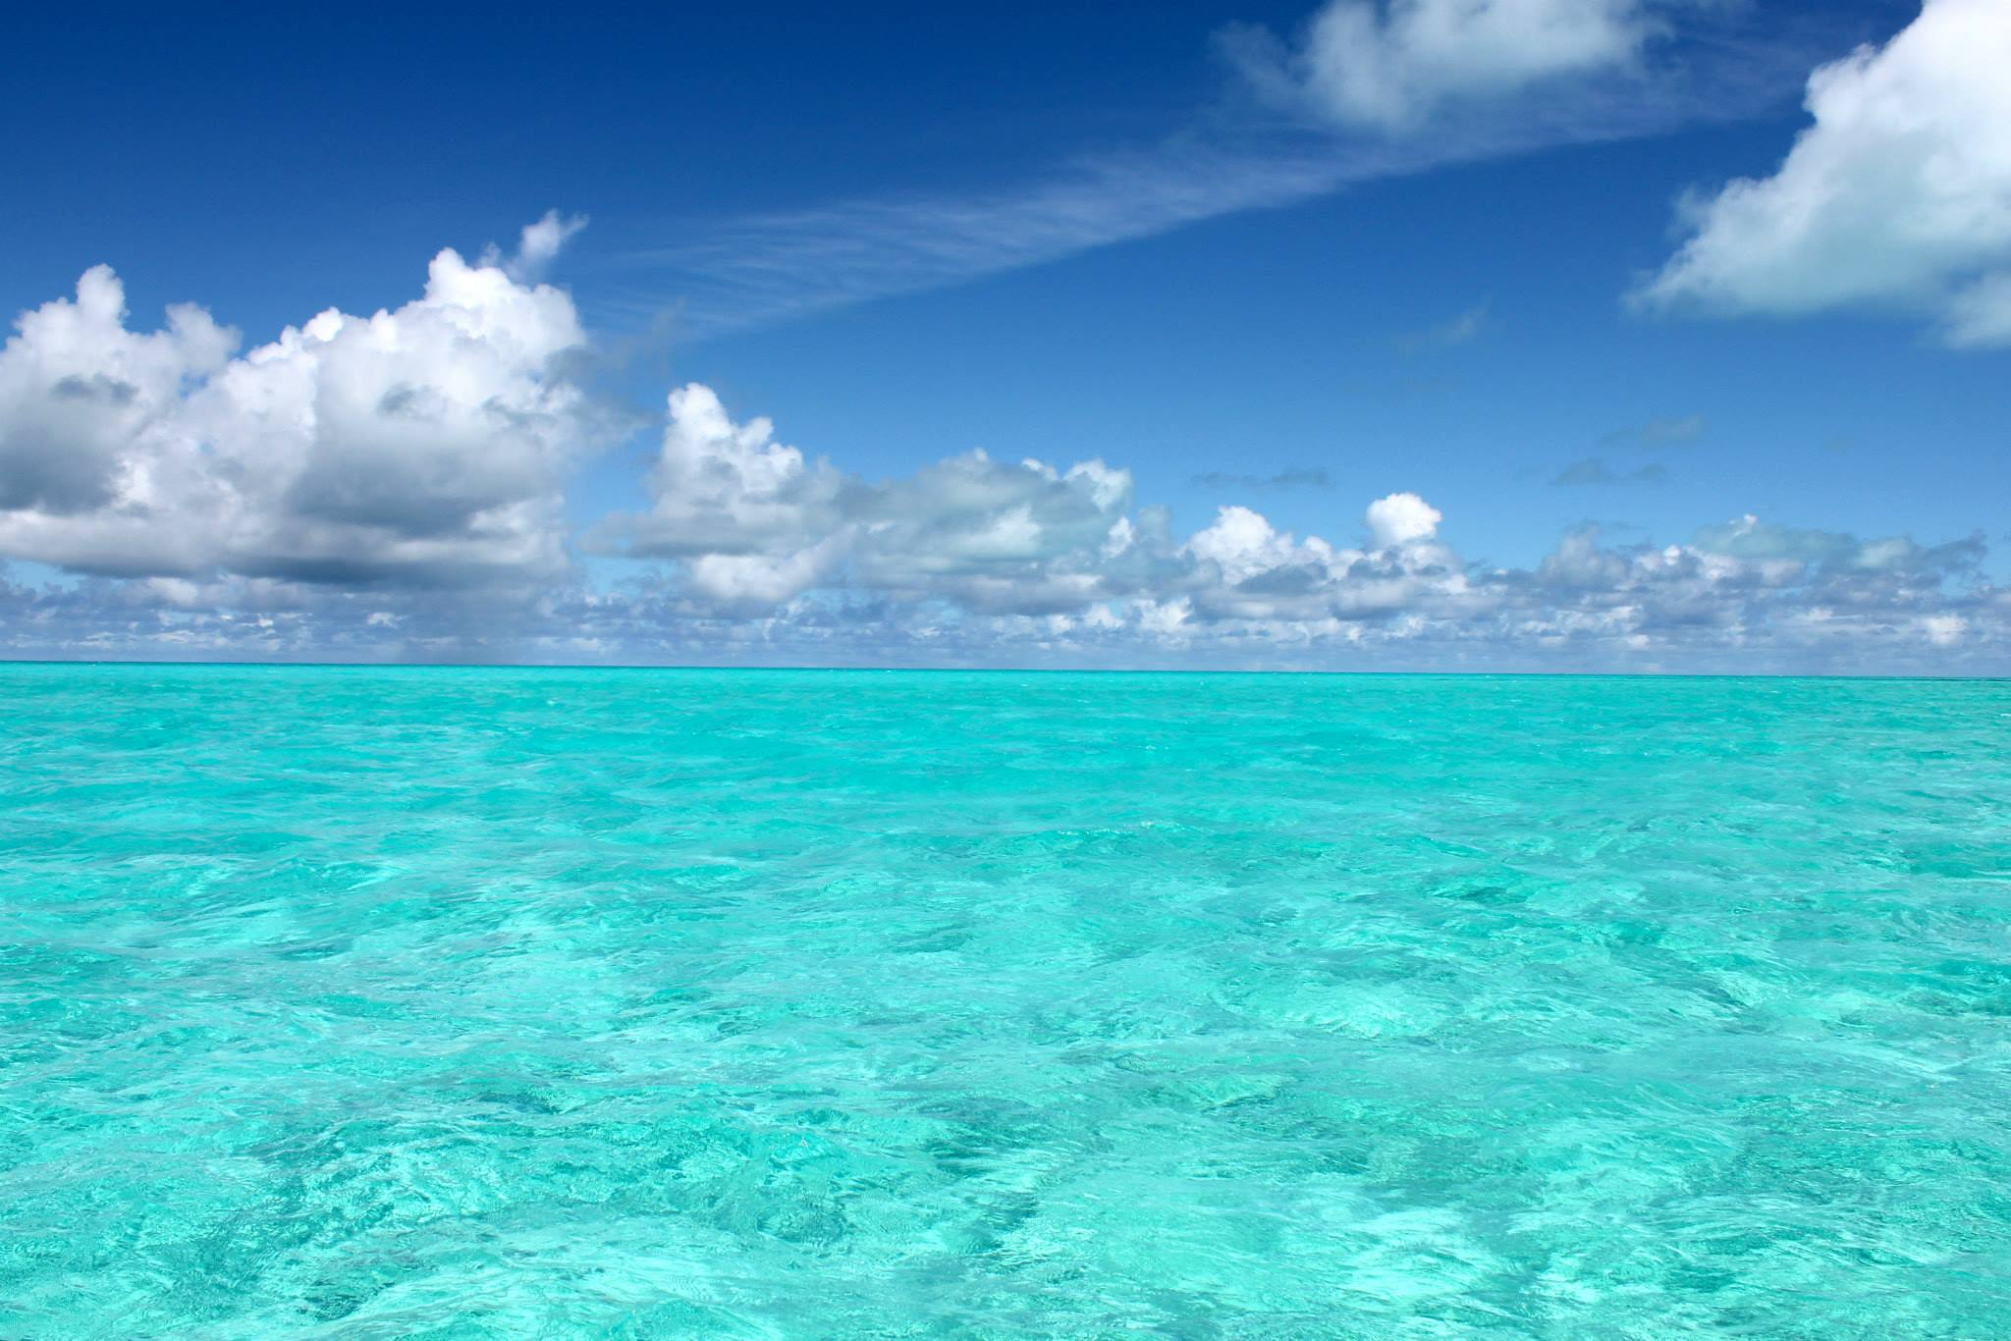
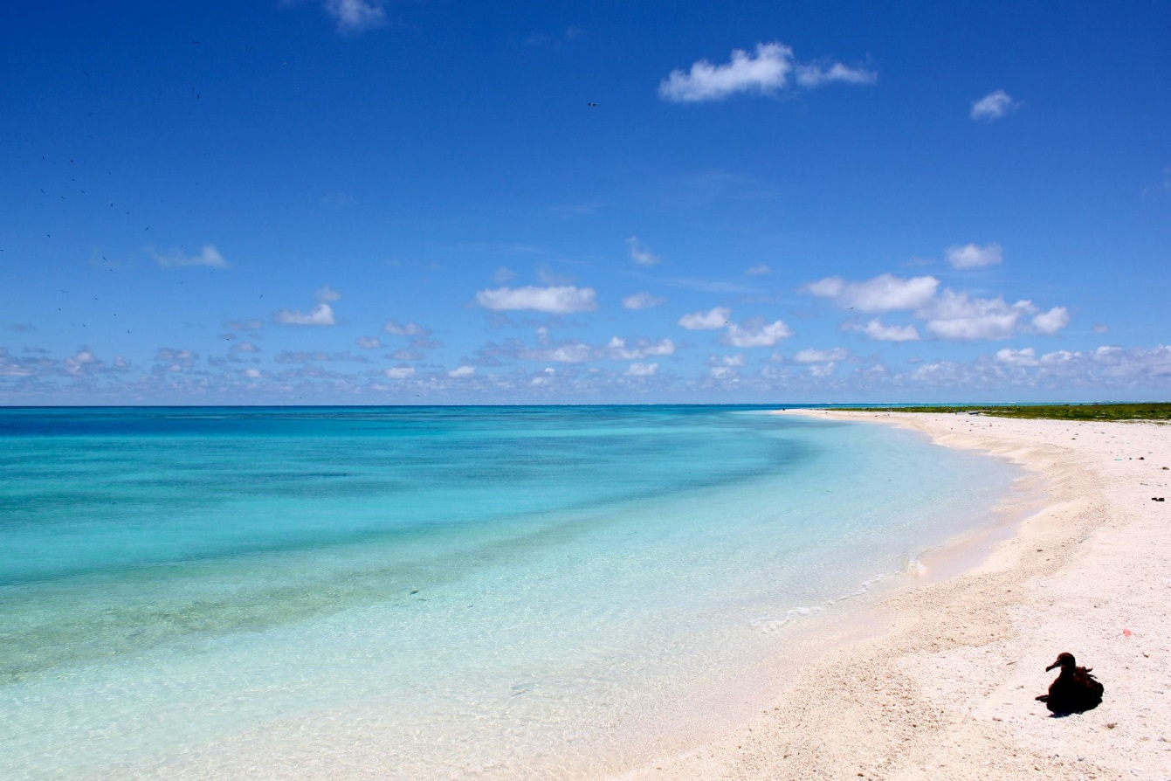

Slide 7
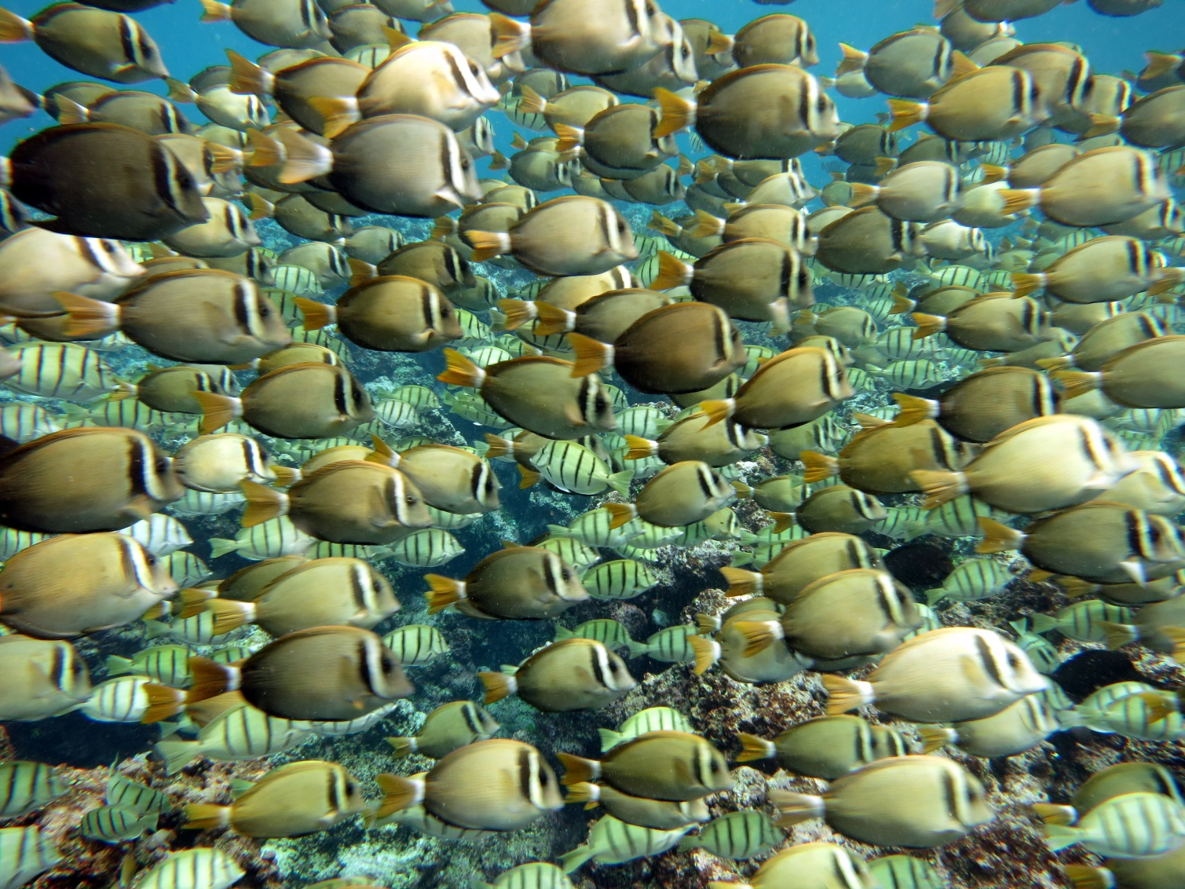
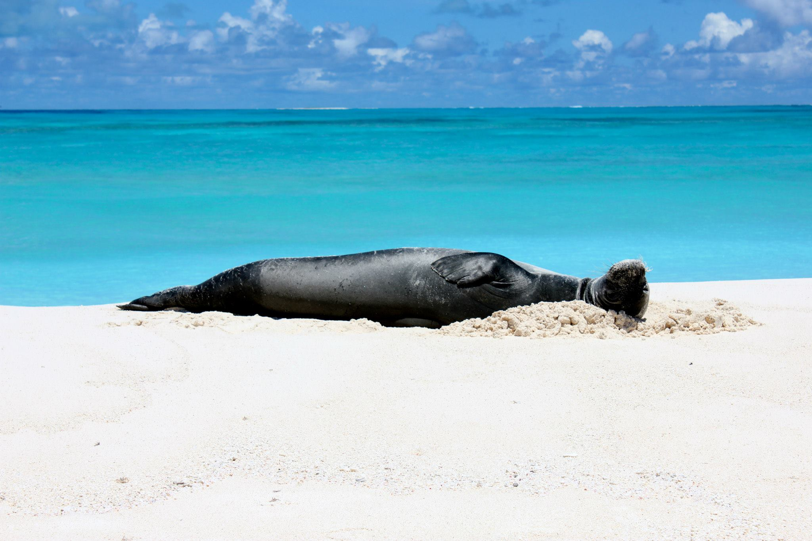
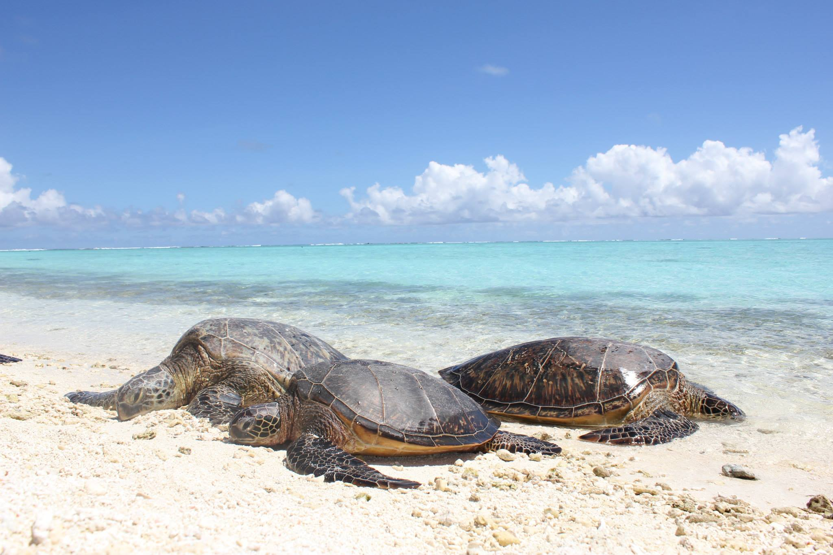
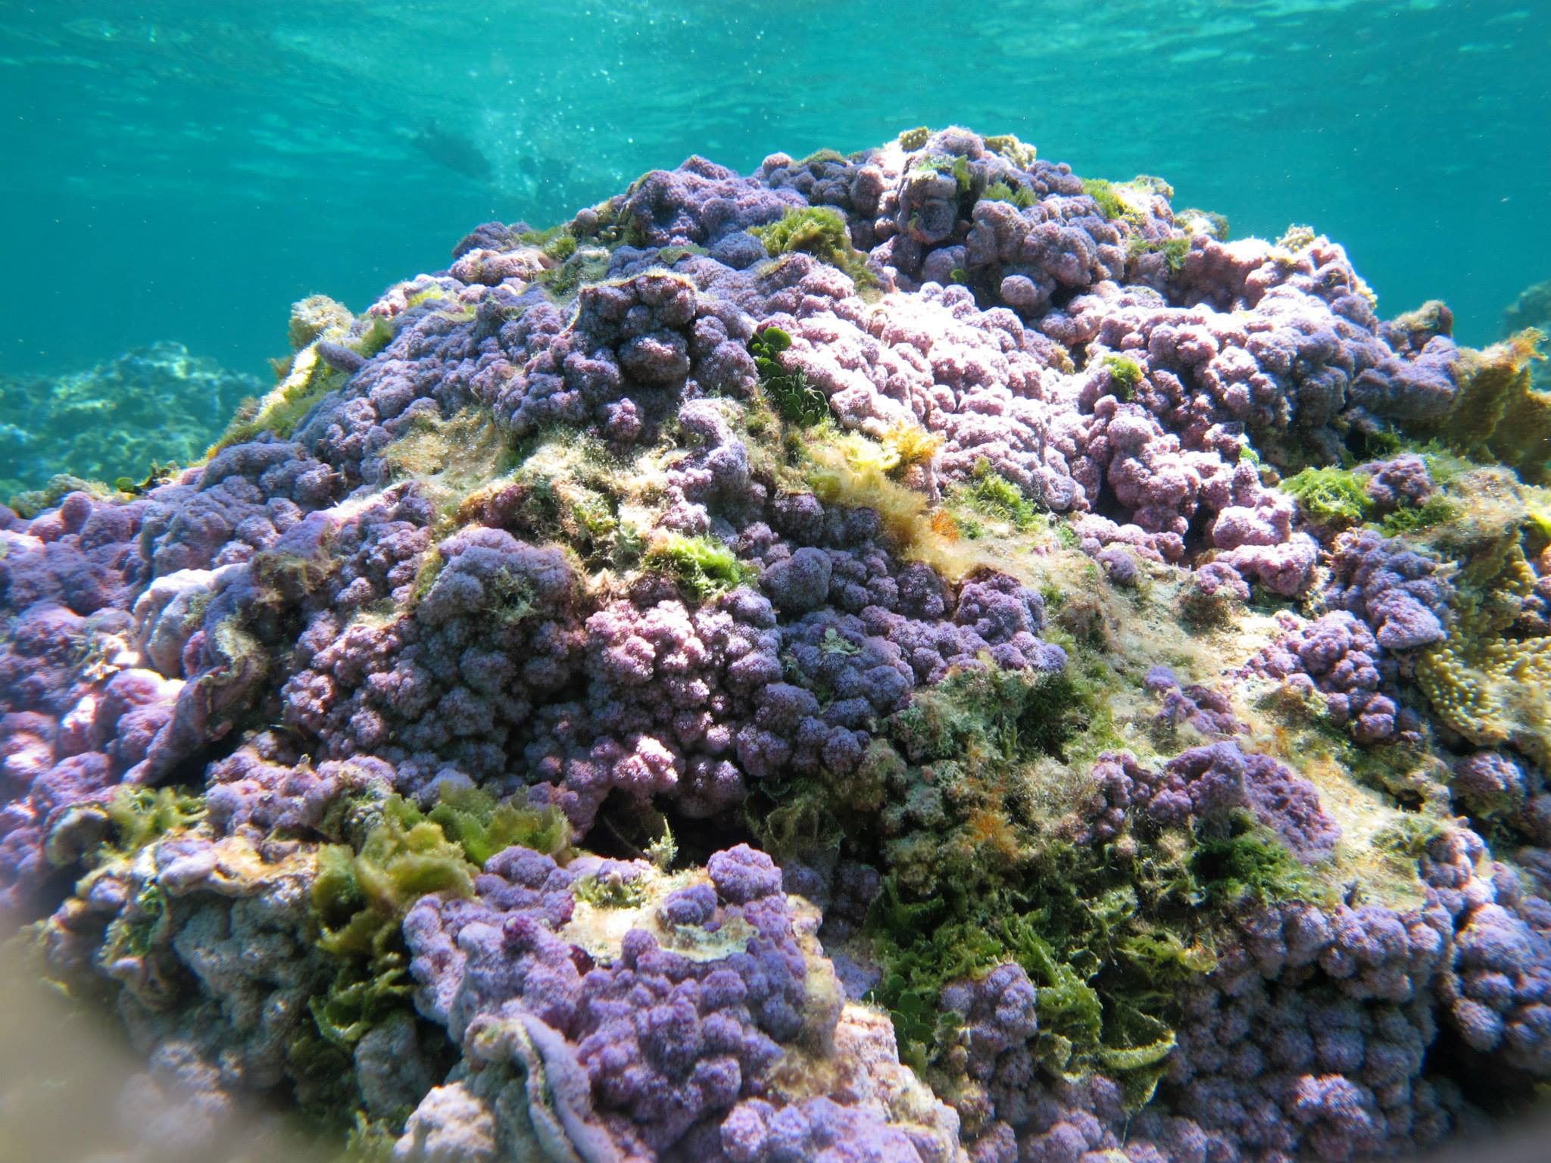

Slide 8
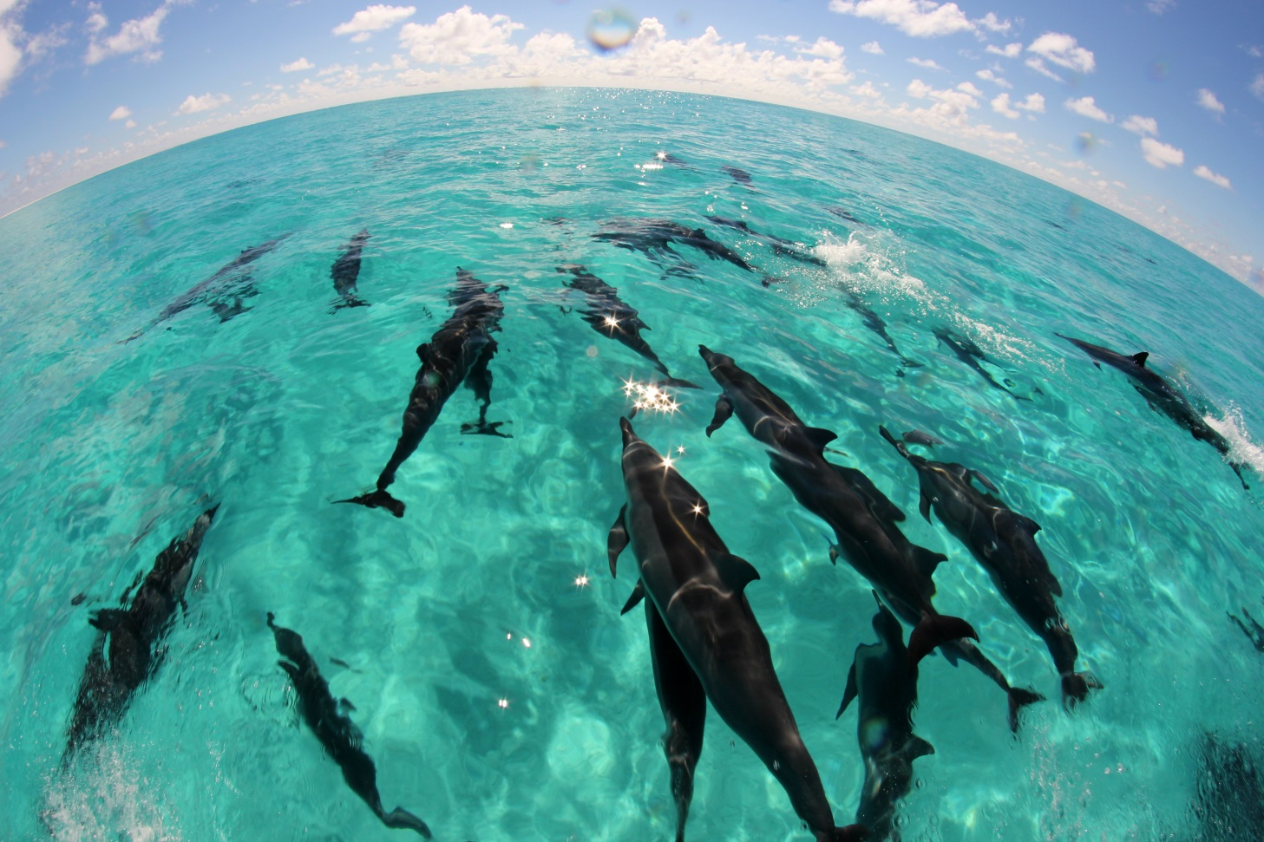
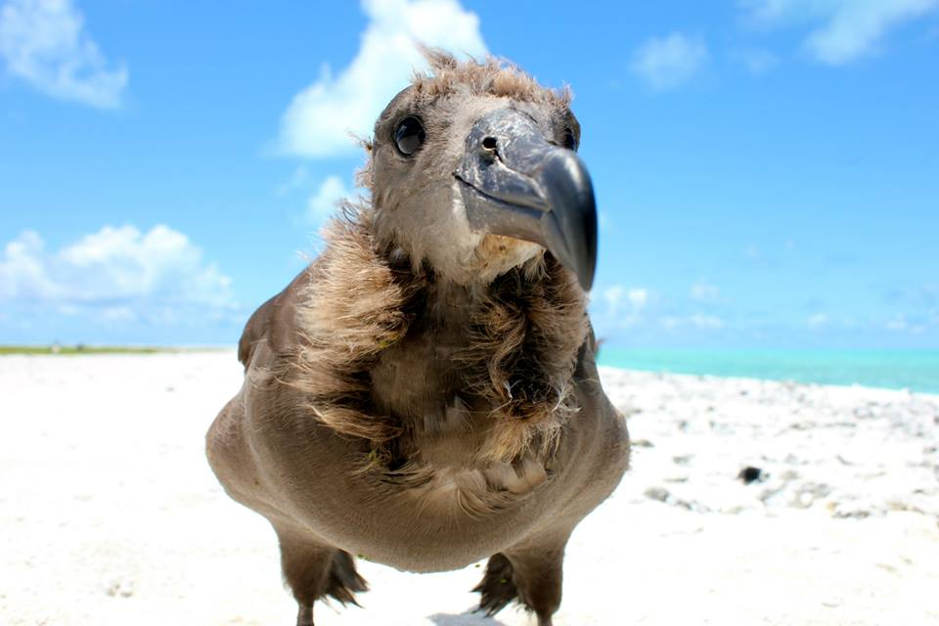
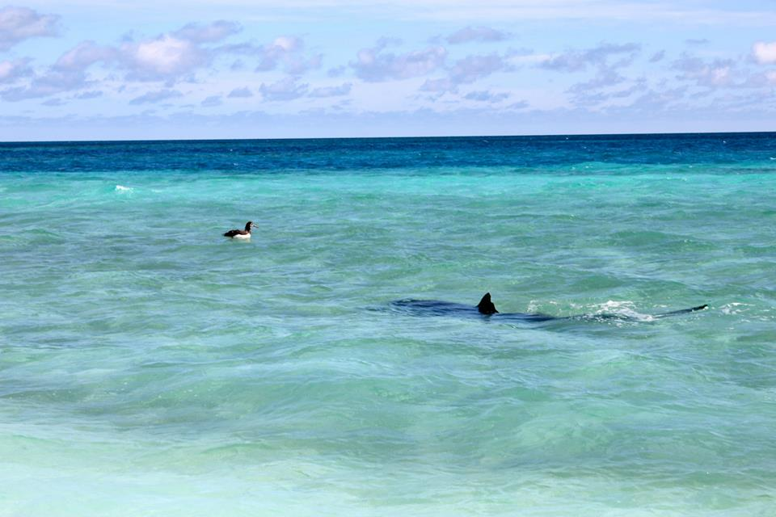

Slide 13
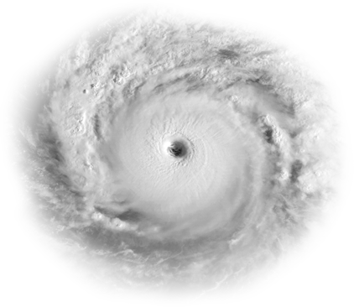

Slide 14
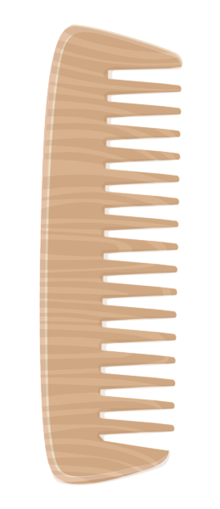

Slide 19
Youngest
Oldest

Slide 20
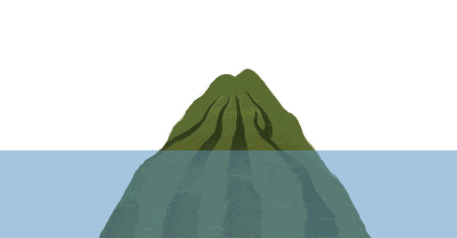

Slide 22
52 metric tons of DFG accumulate in NWHI annually

Slide 23
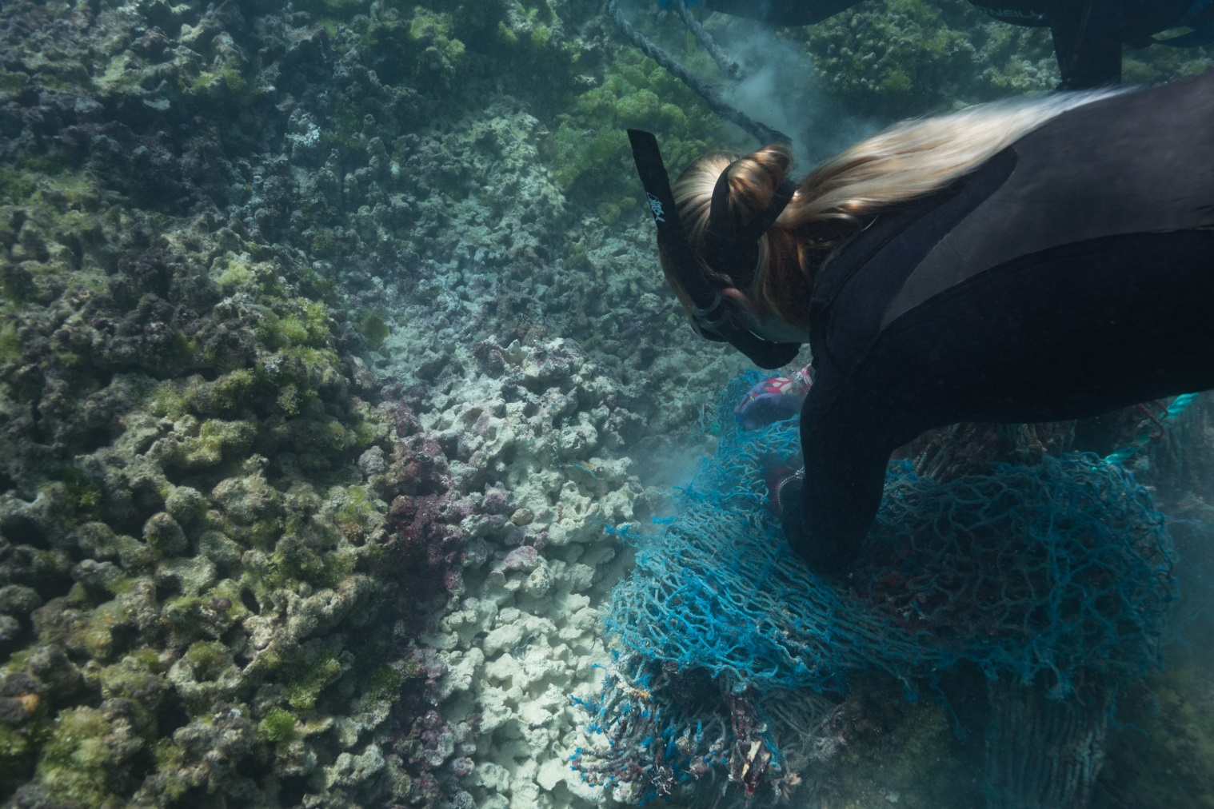
Marine Debris Impacts
Refuse, Reduce, Reuse, Recycle, Remove
How is marine debris affecting the NWHI?
Entanglement
Ingestion
Habitat damage
Non-native species

Slide 24
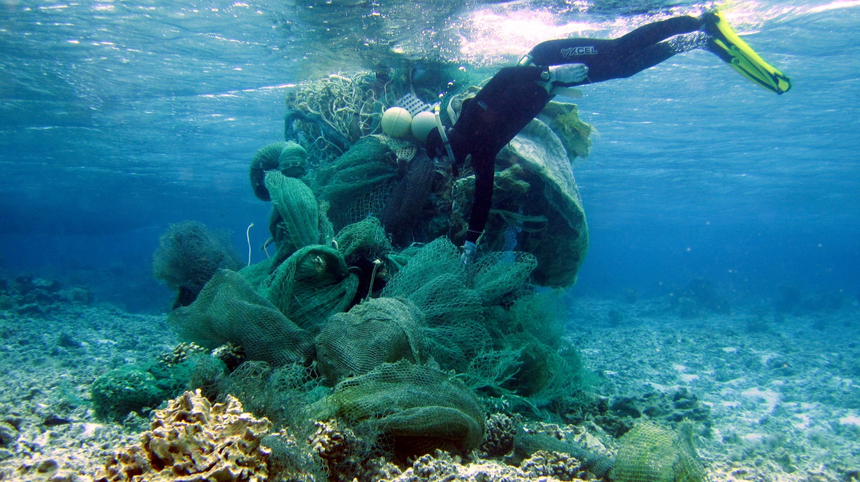
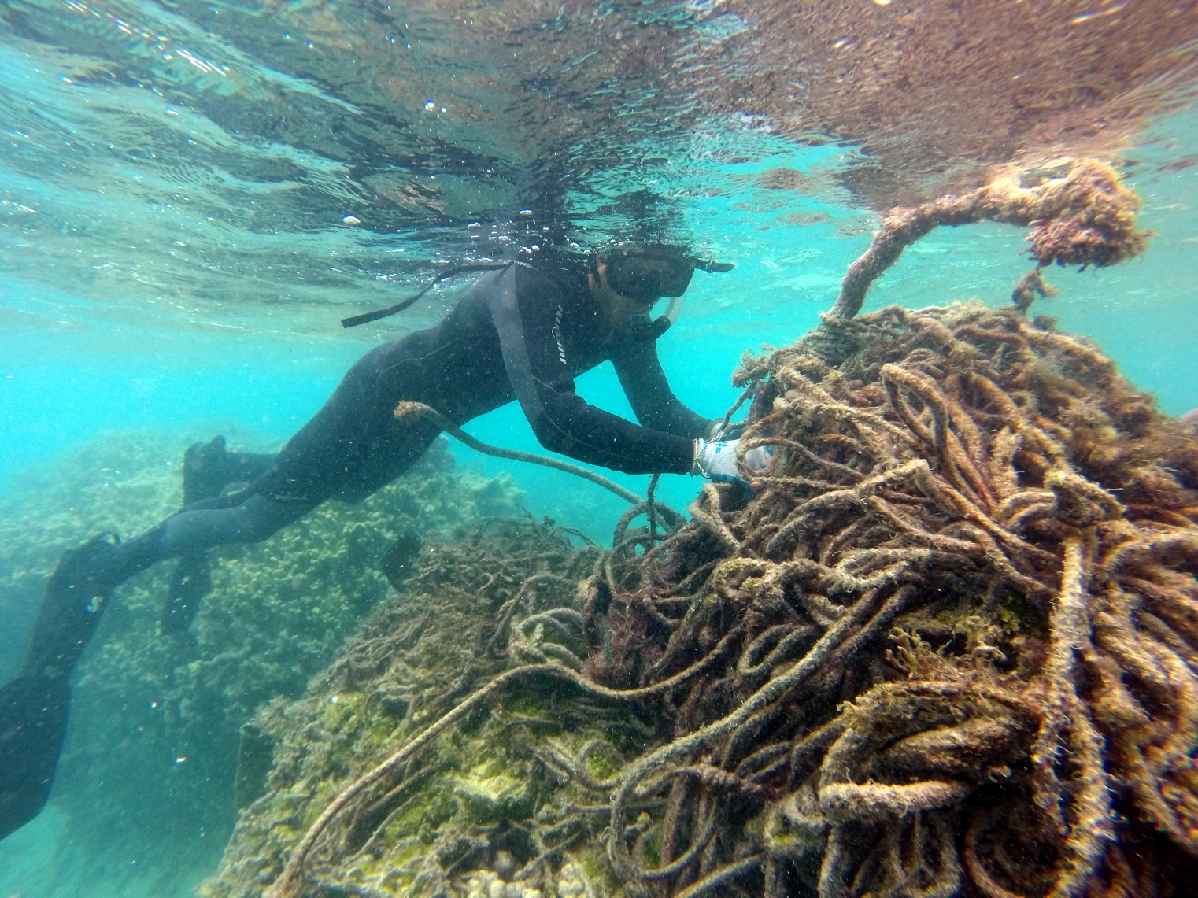
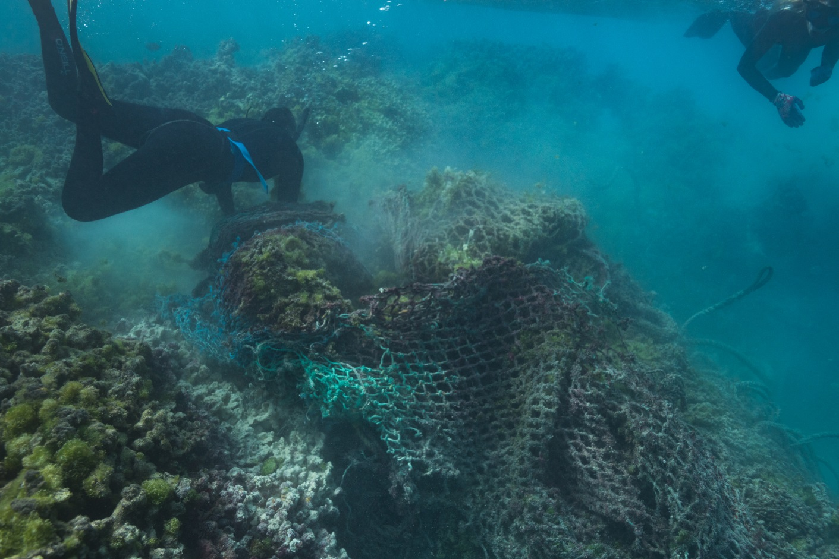
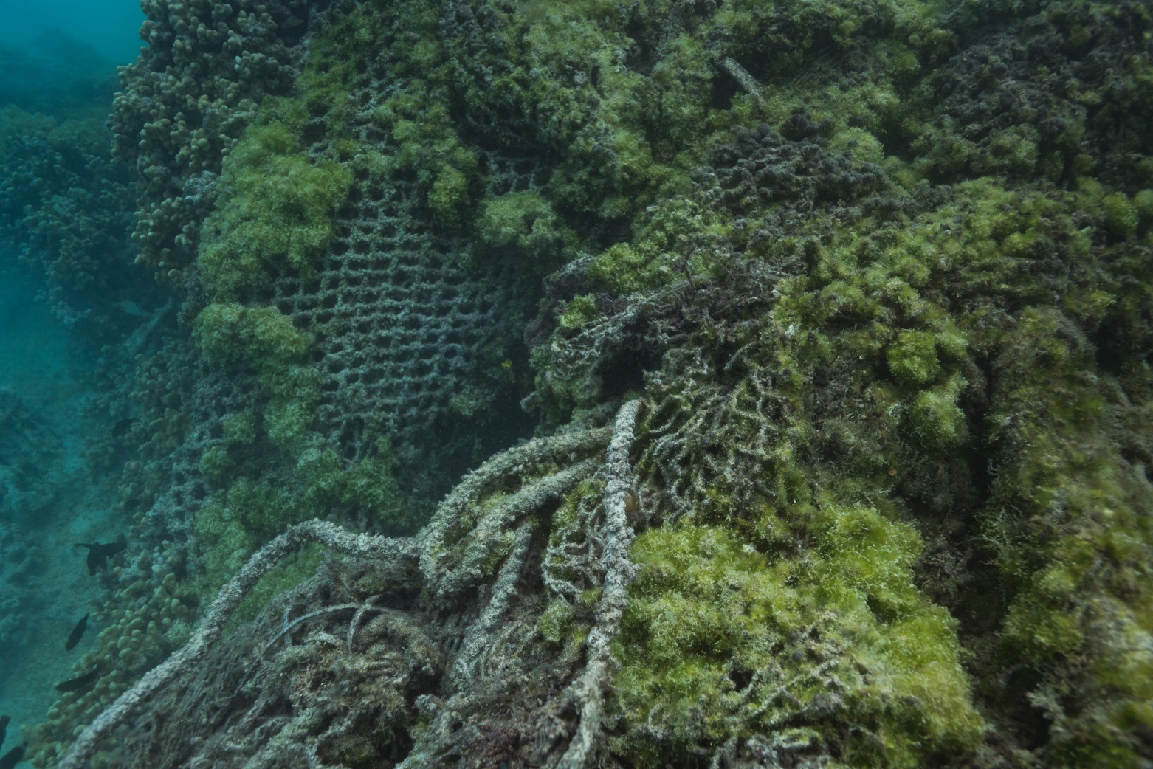

Slide 25
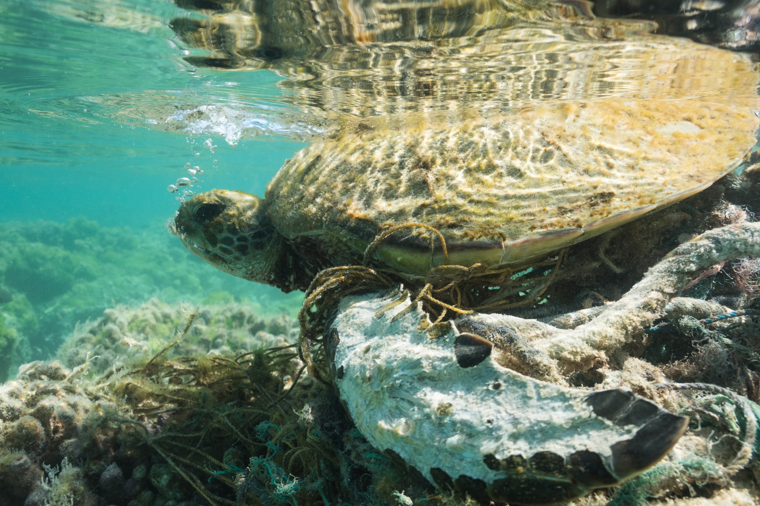
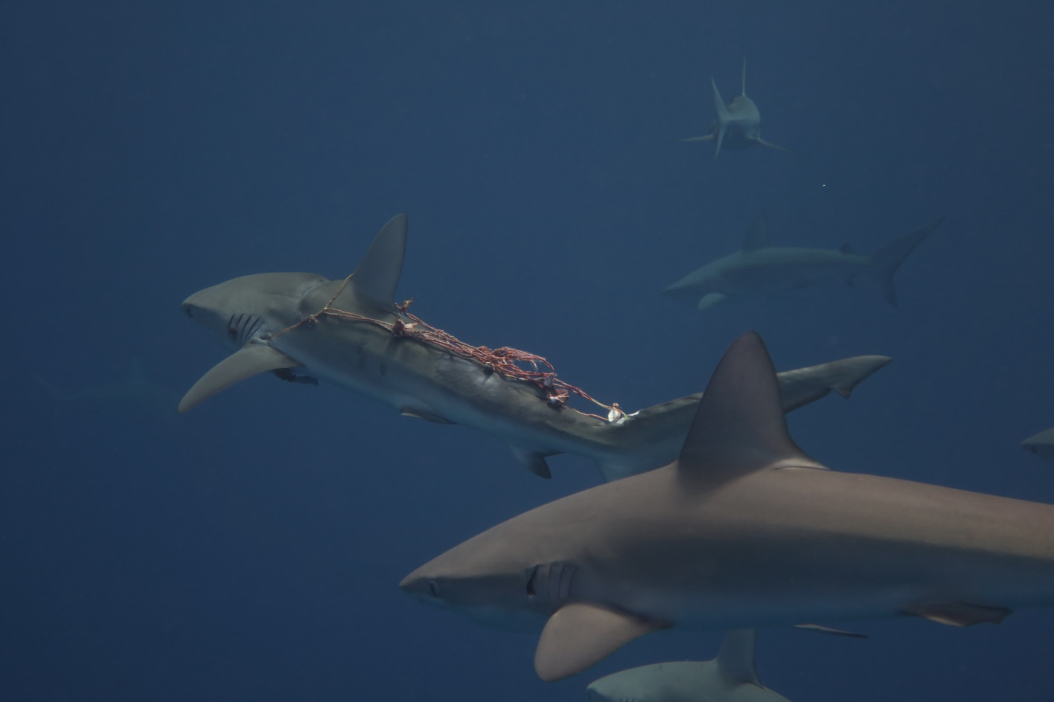
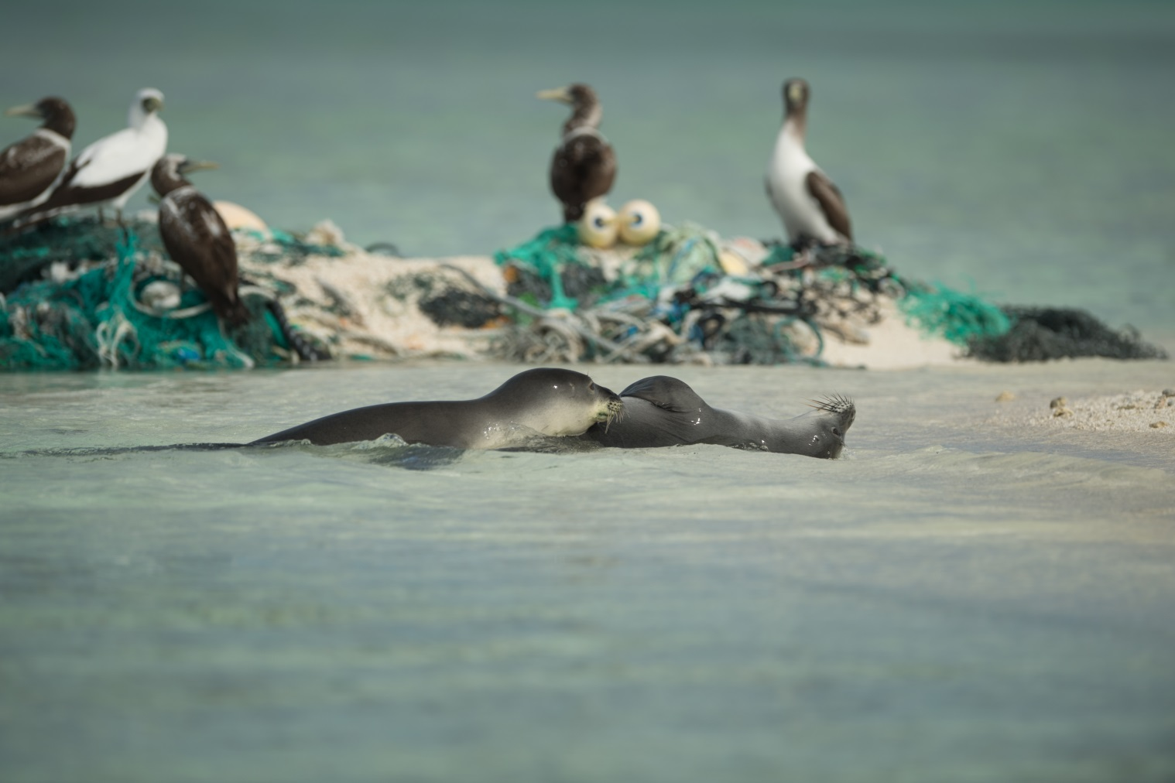

Slide 26
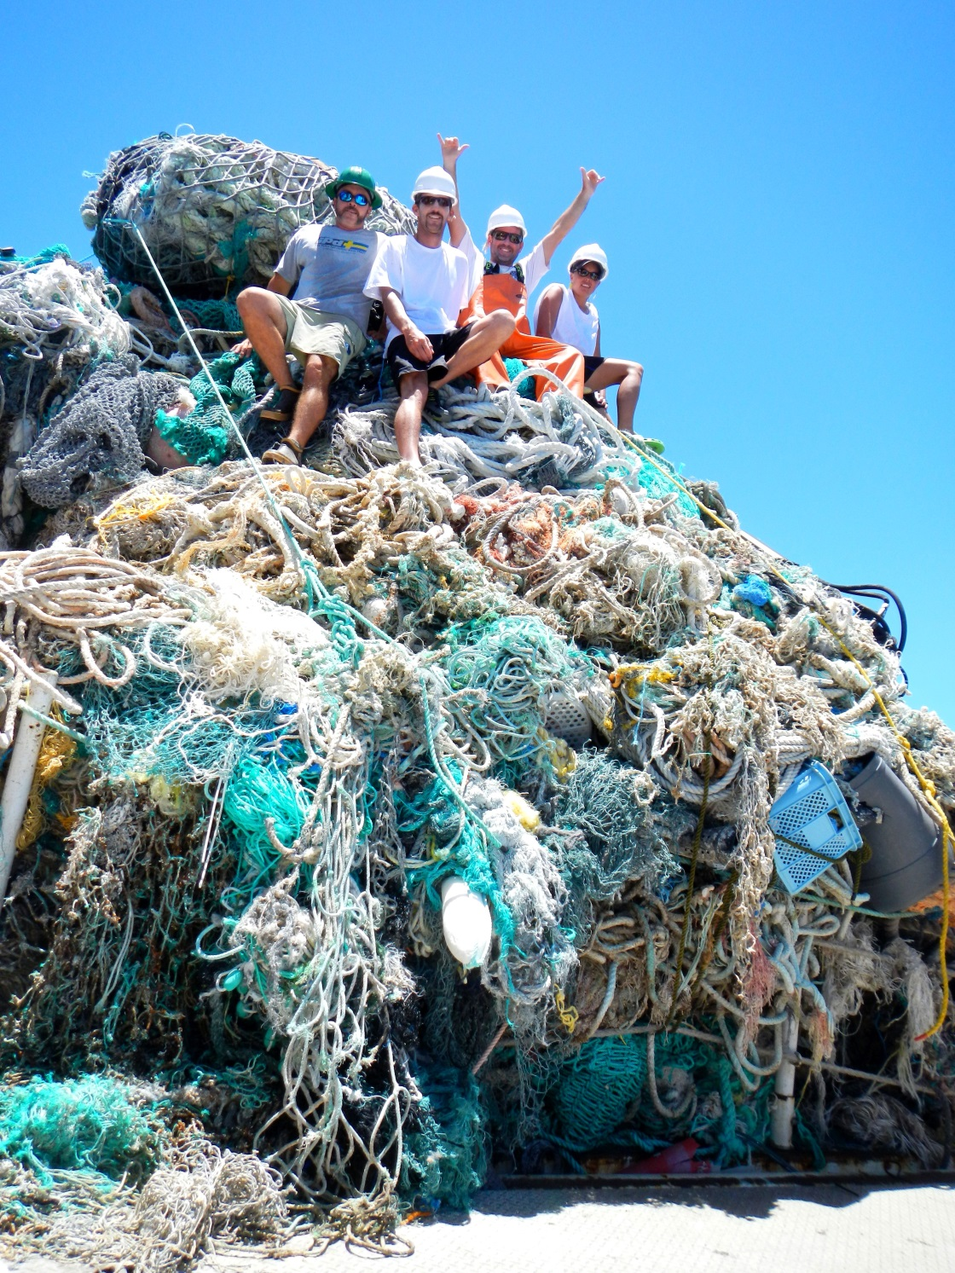
Project History
1996 – Project founded in NWHI
1999 – First full marine debris season
2006 – Papahānaumokuākea Marine National Monument established
2006 – Maintenance mode (annual)
1996 – 2018: 922 metric tons (over 2 million lbs) removed from NWHI

Slide 27
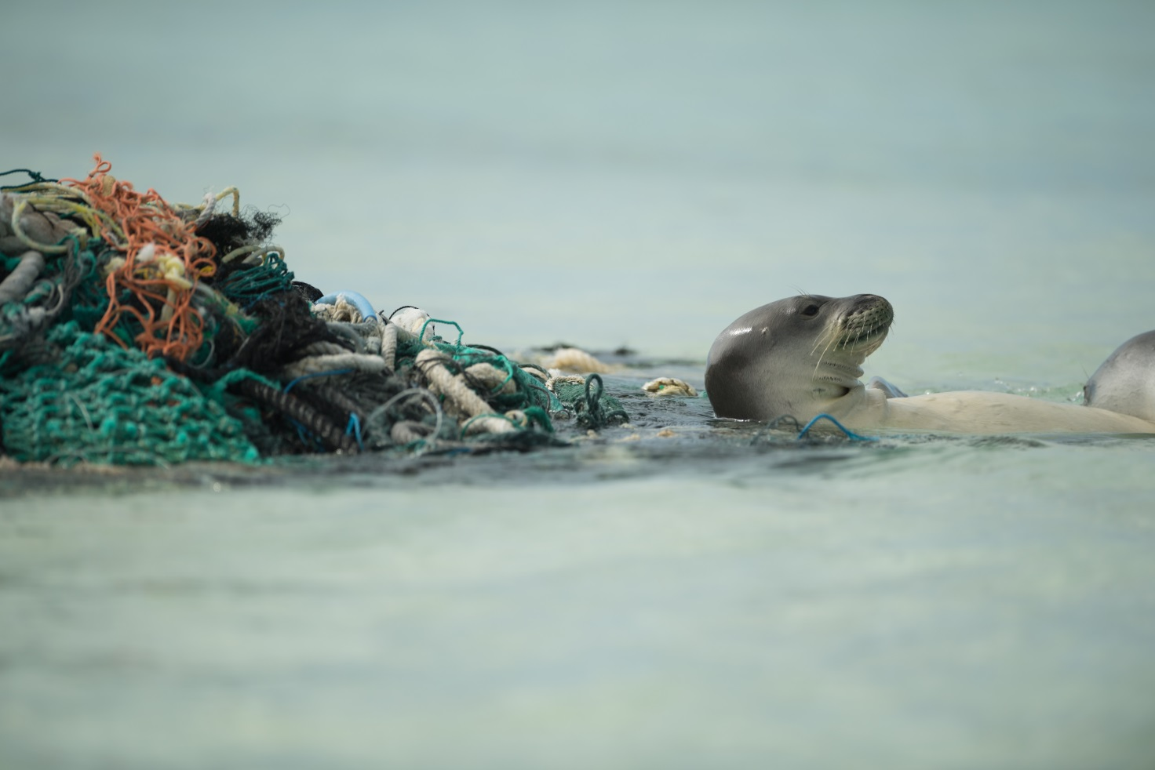
Marine Debris Removal Impacts
1,400 Hawaiian monk seals left in the world
28% of Hawaiian monk seals alive today are because of marine debris removals, disentanglements, and rehabilitation efforts (Harting et al., 2014)

Slide 28
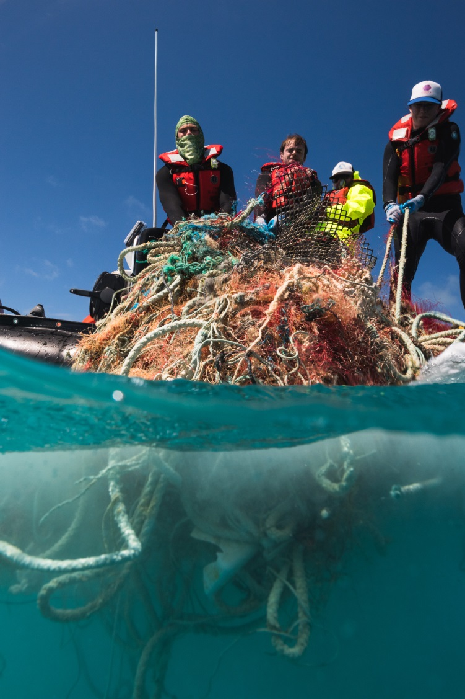
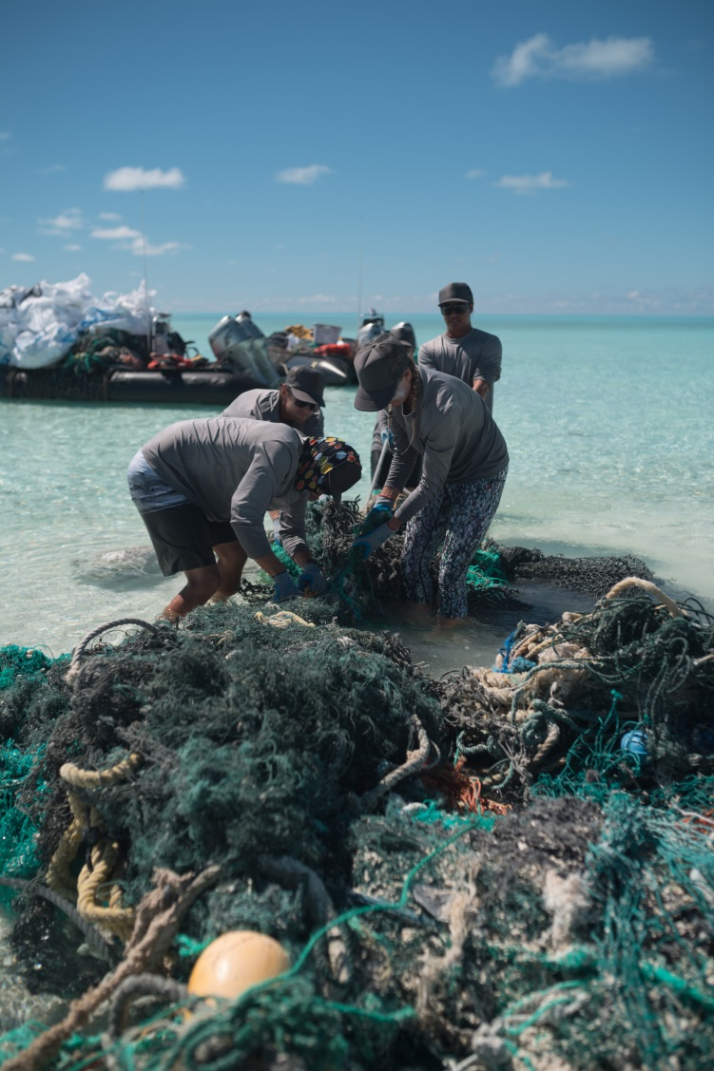
Survey and Removal Methods
Coral reef survey (in-water)
Tow-board (towed diver)
Swim
VS.
Shoreline survey (land)

Slide 29
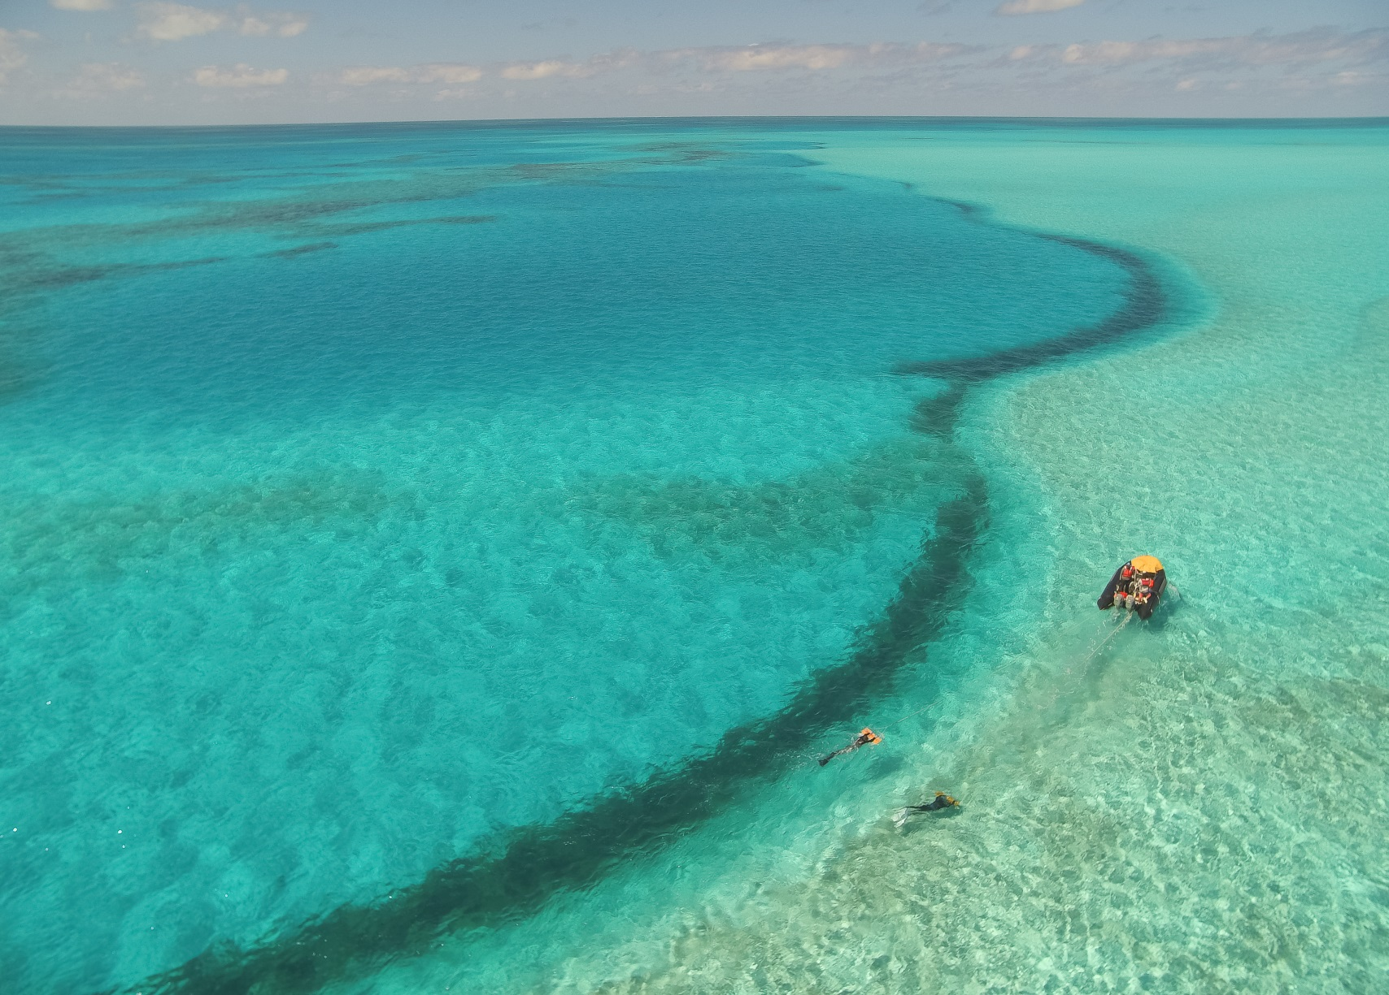
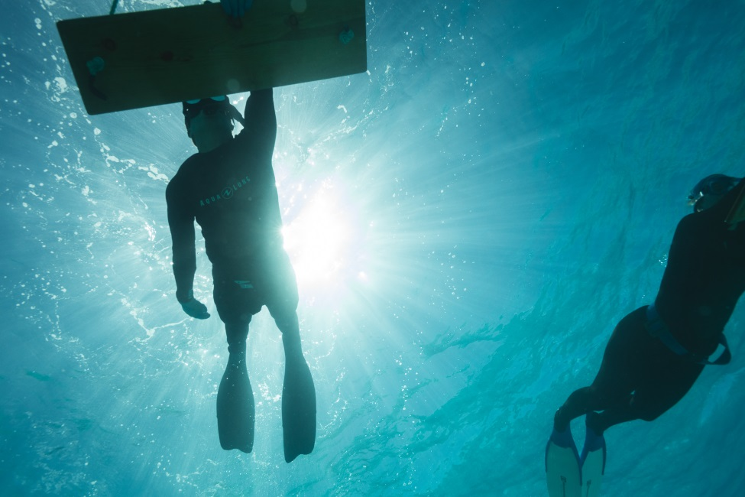
Survey and Removal Methods - Towboard
Coral reef survey
Tow-board
Back-reef
Free-dive

Slide 30
Fore-reef
Back-reef

Slide 31
Back-reef
Fore-reef

Slide 32
Back-reef

Slide 34
0.25 km²
*Not to scale

Slide 39
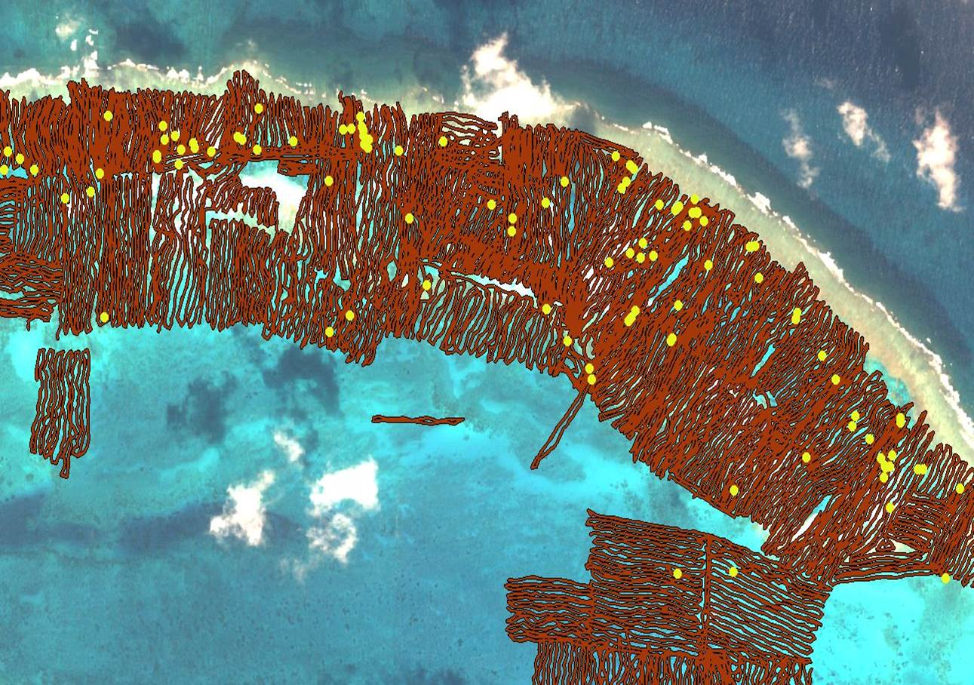

Slide 40
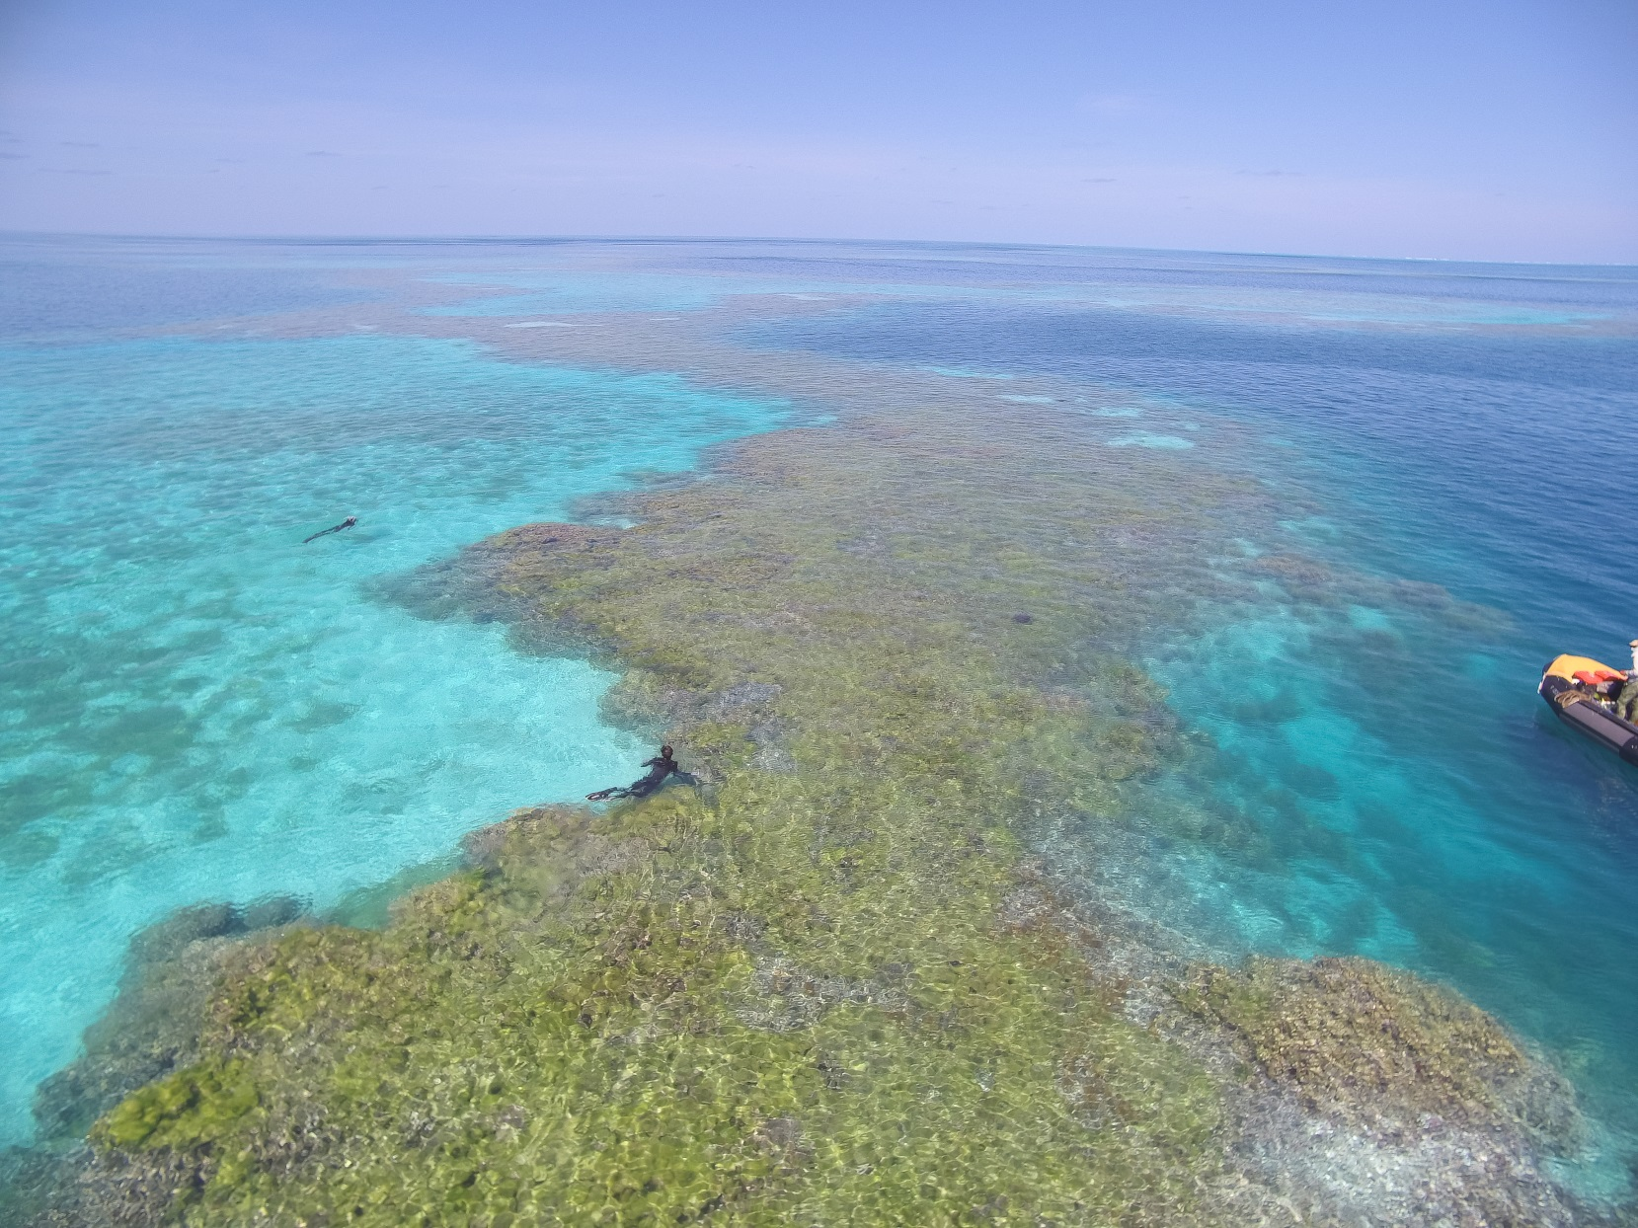
Survey and Removal Methods - Swim
Coral reef survey
Swim / Snorkel
Free-dive

Slide 41
Patch reefs

Slide 51
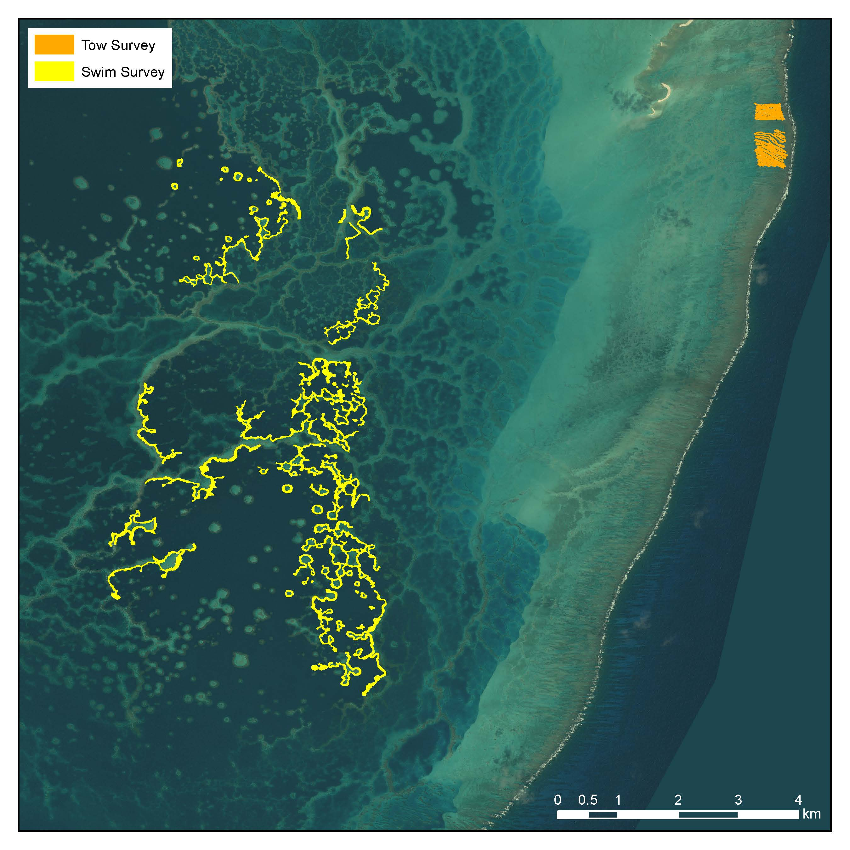

Slide 53
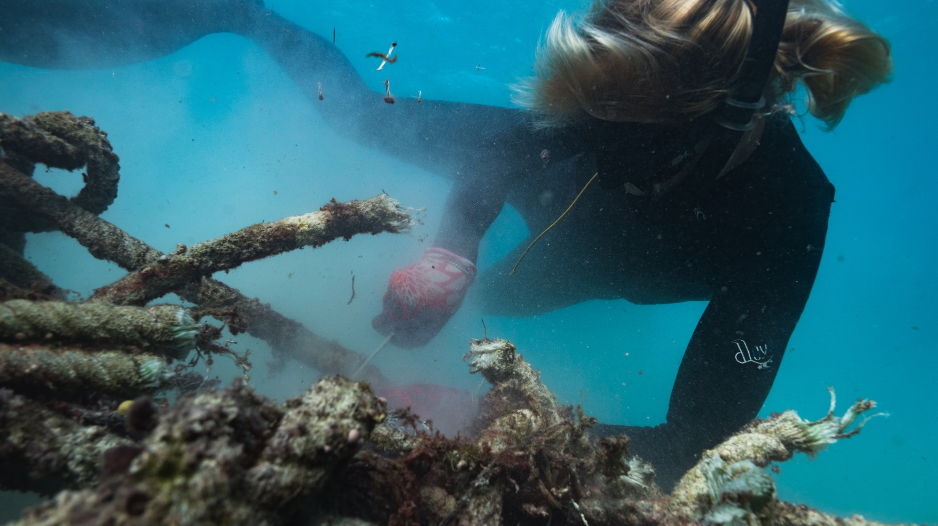
Survey and Removal Methods – In-water
Net is visually identified and GPS marked
Data is collected on the nets
Dive teams breath-hold dive to cut and remove net (<30 ft depth)
Nets are manually hauled into small boats
Net loads are craned out of boats onto ship

Slide 54
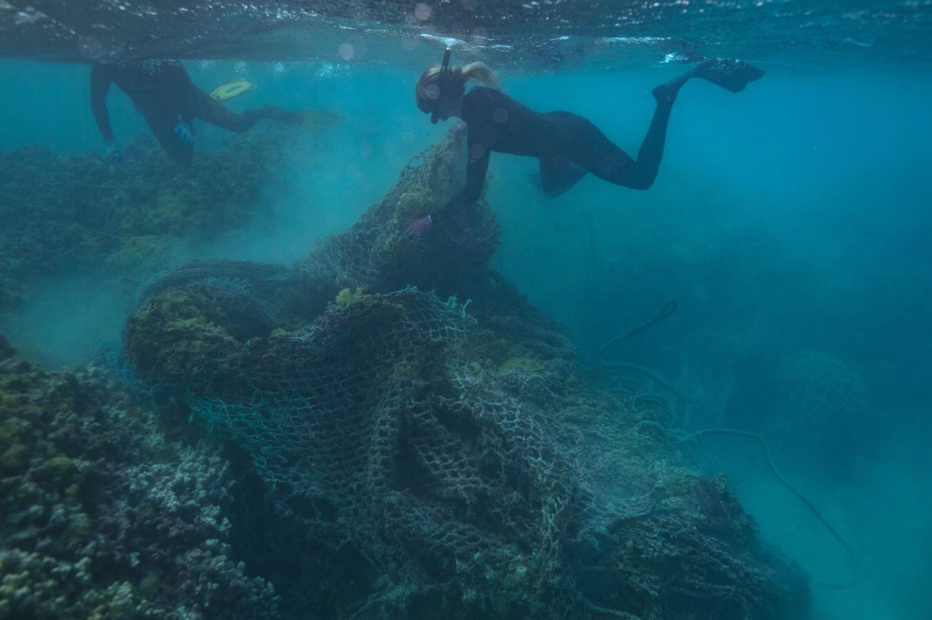
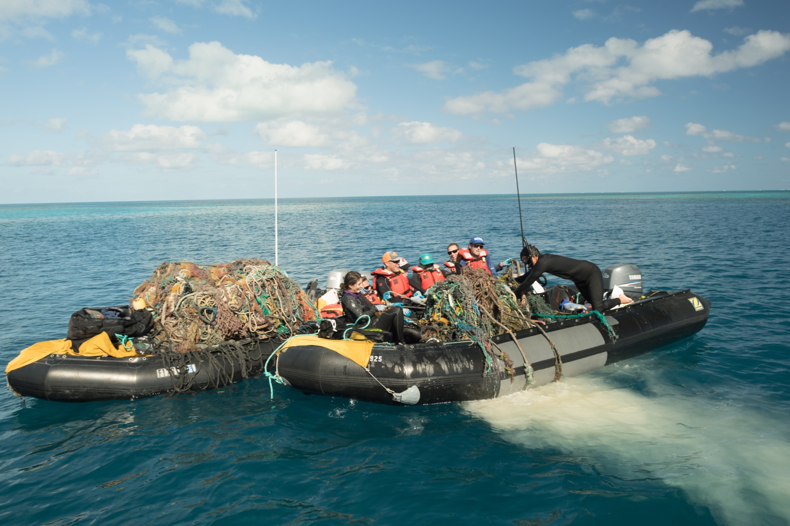
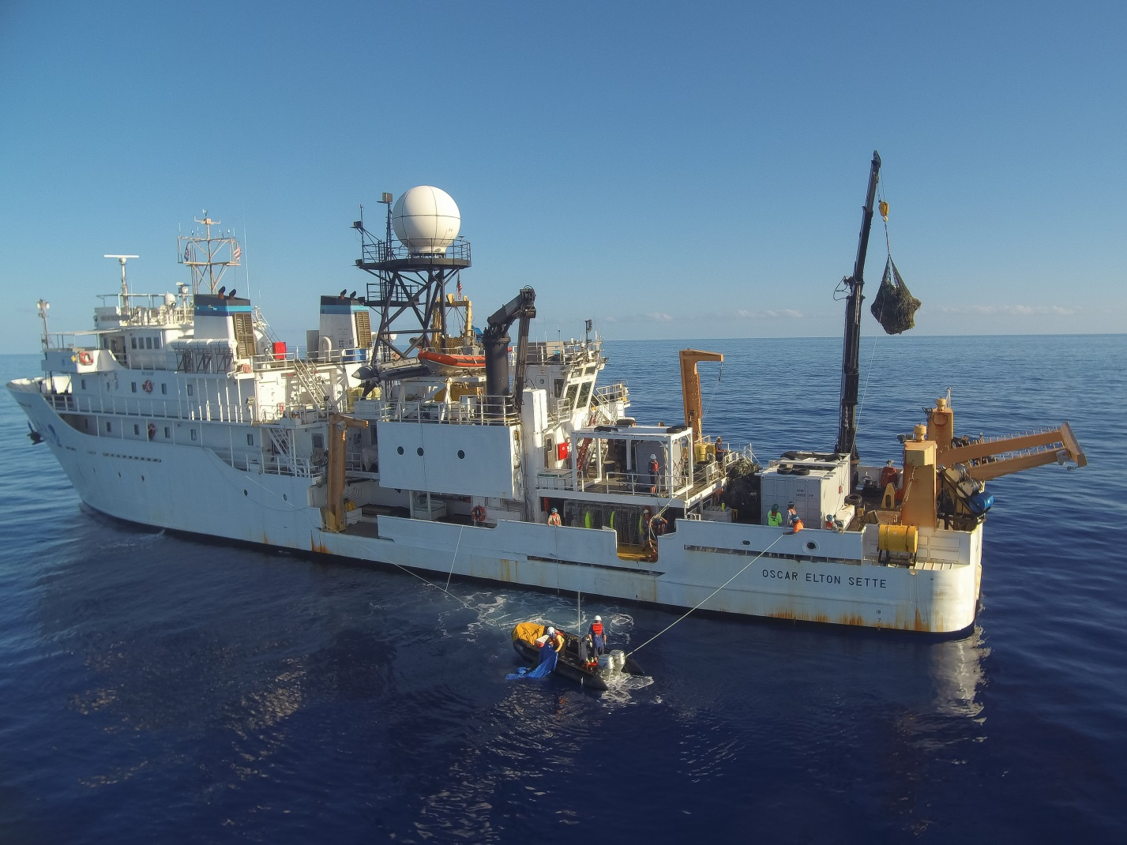

Slide 55
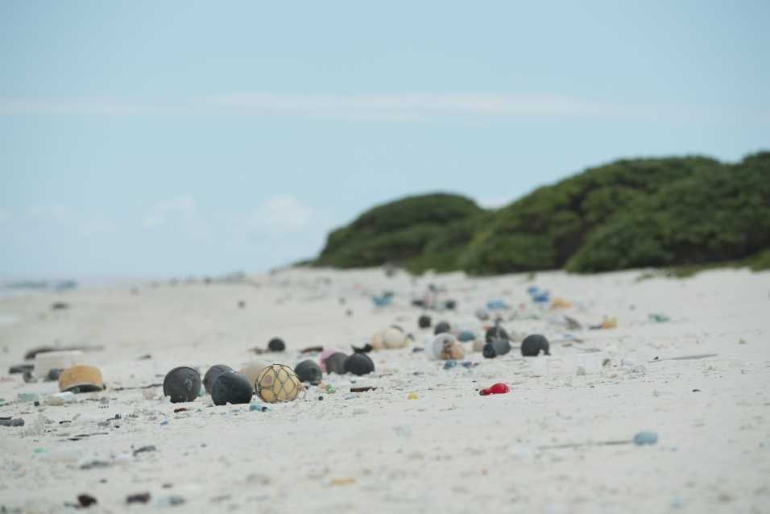
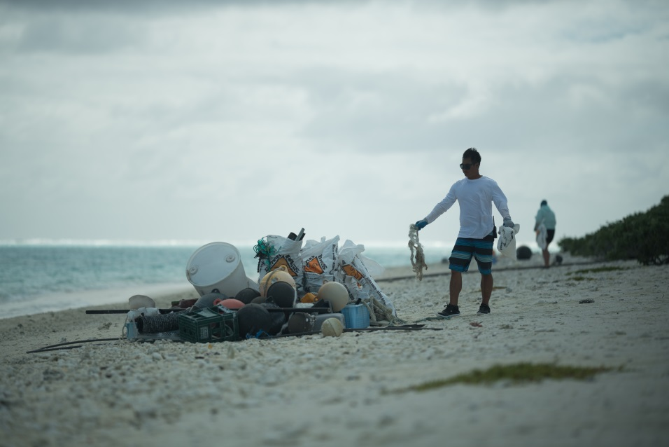
Survey and Removal Methods – Land
Nets and plastics are removed from the shoreline
Priority is to remove entanglement hazards to Hawaiian monk seals, green sea turtles, and sea birds
Debris is loaded manually into bulk bags on small boats
Debris is craned out of the boat onto ship

Slide 56
Play debris survey video
Play debris survey video

Slide 57
2018 Field Mission
41-day mission (September 19 – October 30, 2018)
NOAA R/V Oscar Elton Sette (September 19 – October 11)
51,504 lbs removed
Midway Atoll shore-based (October 5-25)
63,240 lbs removed
M/V Imua (October 13-30)
49,269 lbs removed
Total: 164,013 lbs (74 metric tons) removed

Slide 58
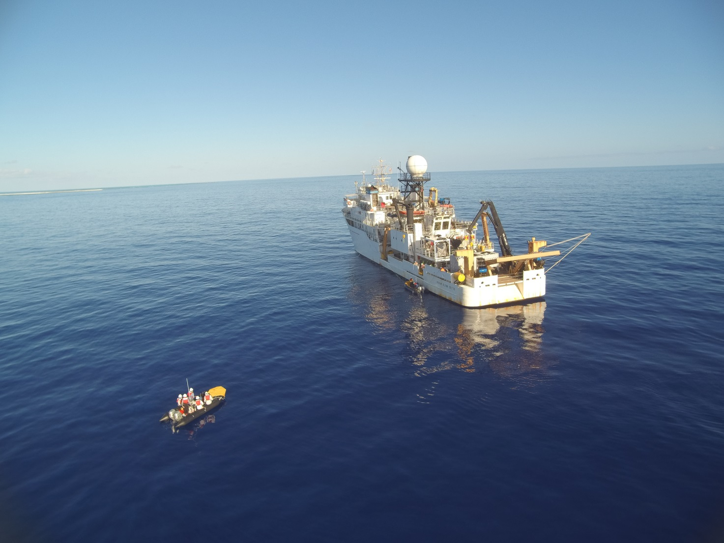
2018 Field Mission – Leg 1 – R/V Oscar Elton Sette
September 19 – October 11, 2018
19 staff (17 divers/coxswains + 1 UAS pilot + 1 data manager)
In-water removal operations
2.23 km² reef area surveyed and cleaned
51,504 lbs removed

Slide 59
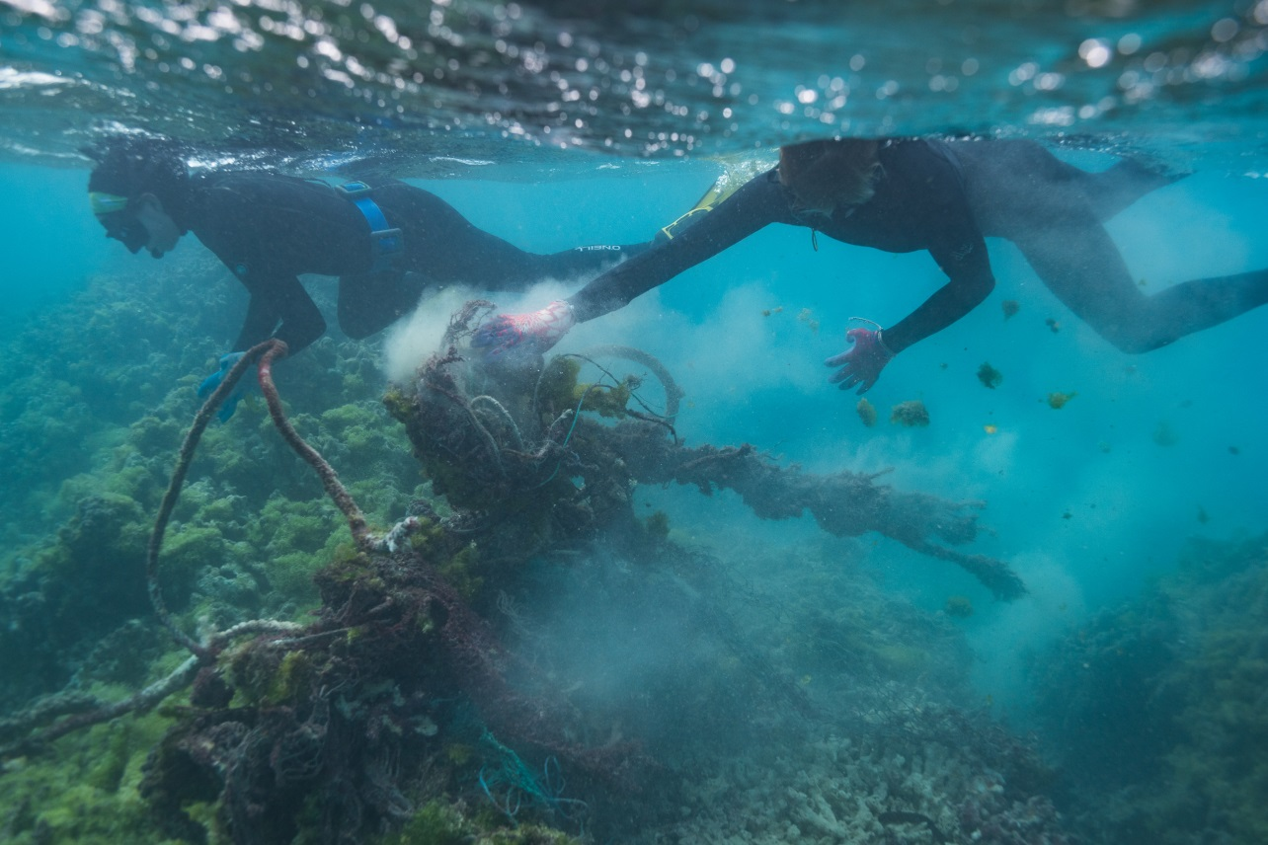
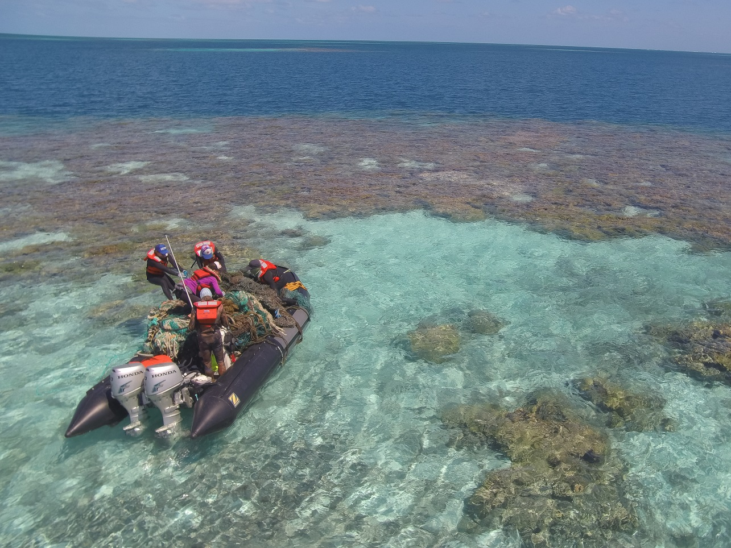
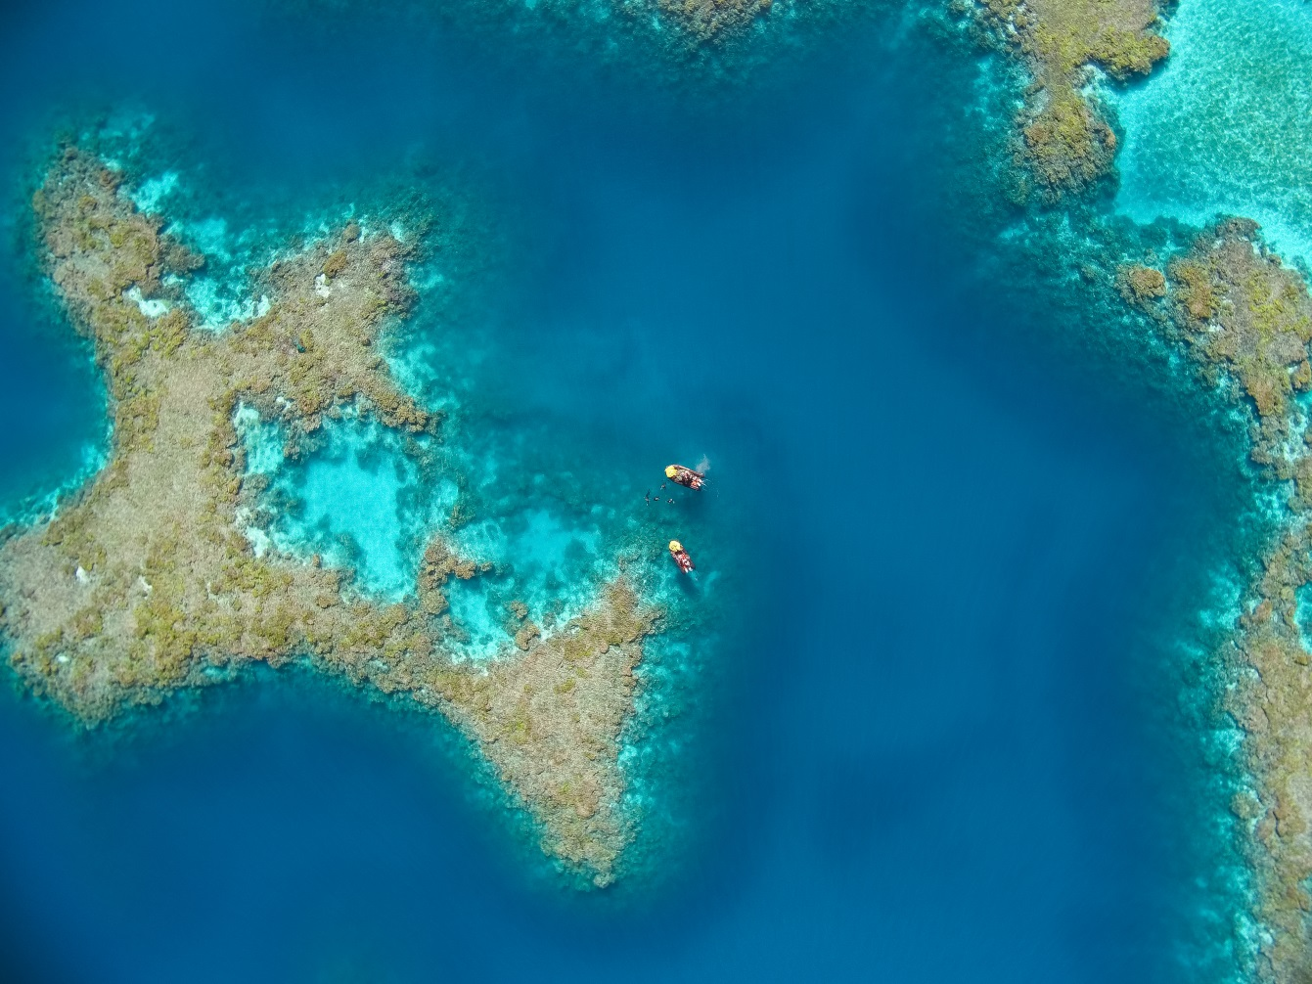

Slide 60
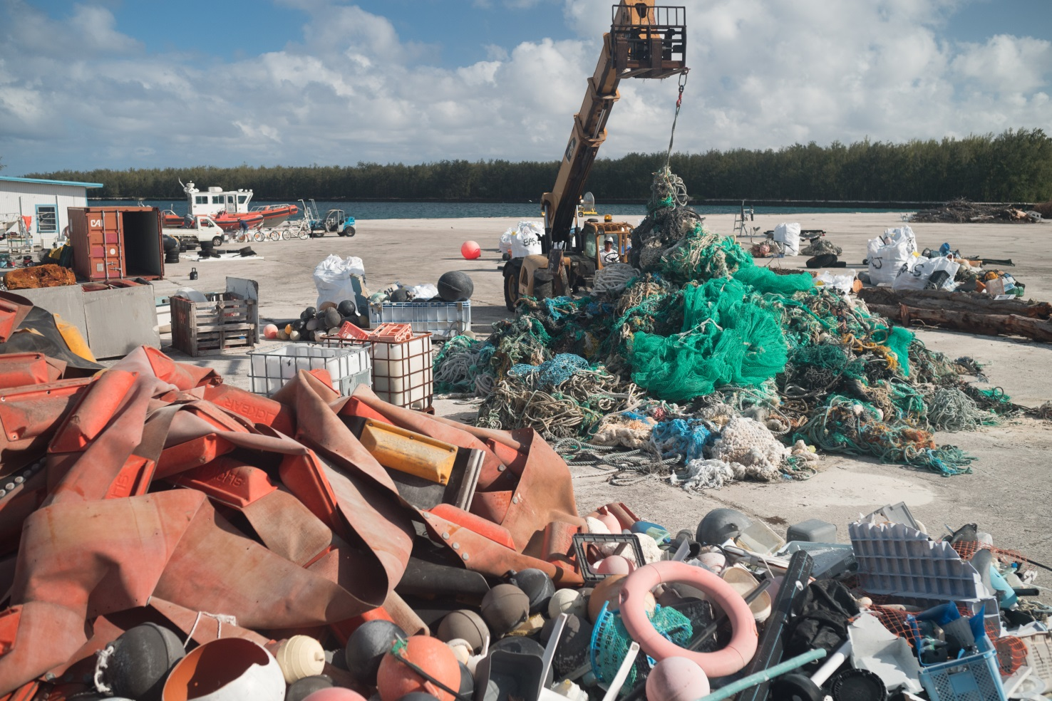
2018 Field Mission – Leg 2 – Midway Atoll
October 5-25, 2018
15 staff (14 divers/coxswains + 1 UAS pilot) – October 5-12
5 staff (5 divers/coxswains) – October 13-25
In-water and shoreline removal operations
1.35 km² reef area surveyed and cleaned
0.41 km² shoreline surveyed and cleaned
63,240 lbs removed

Slide 62
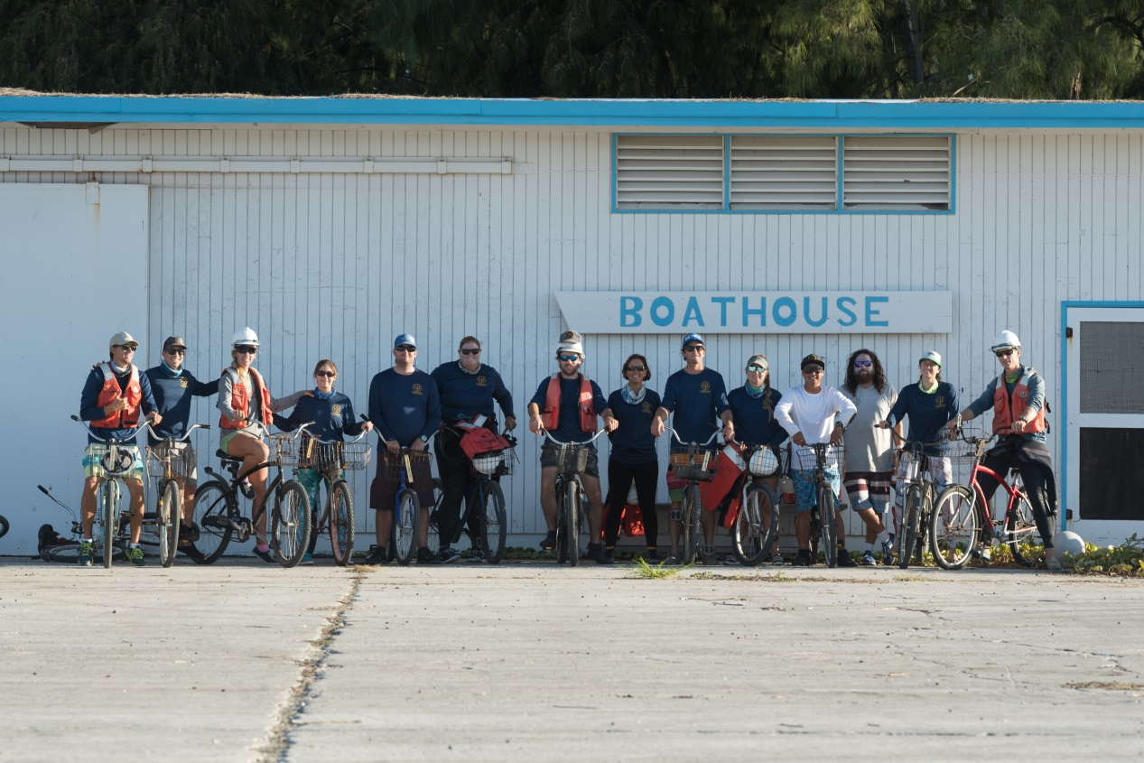
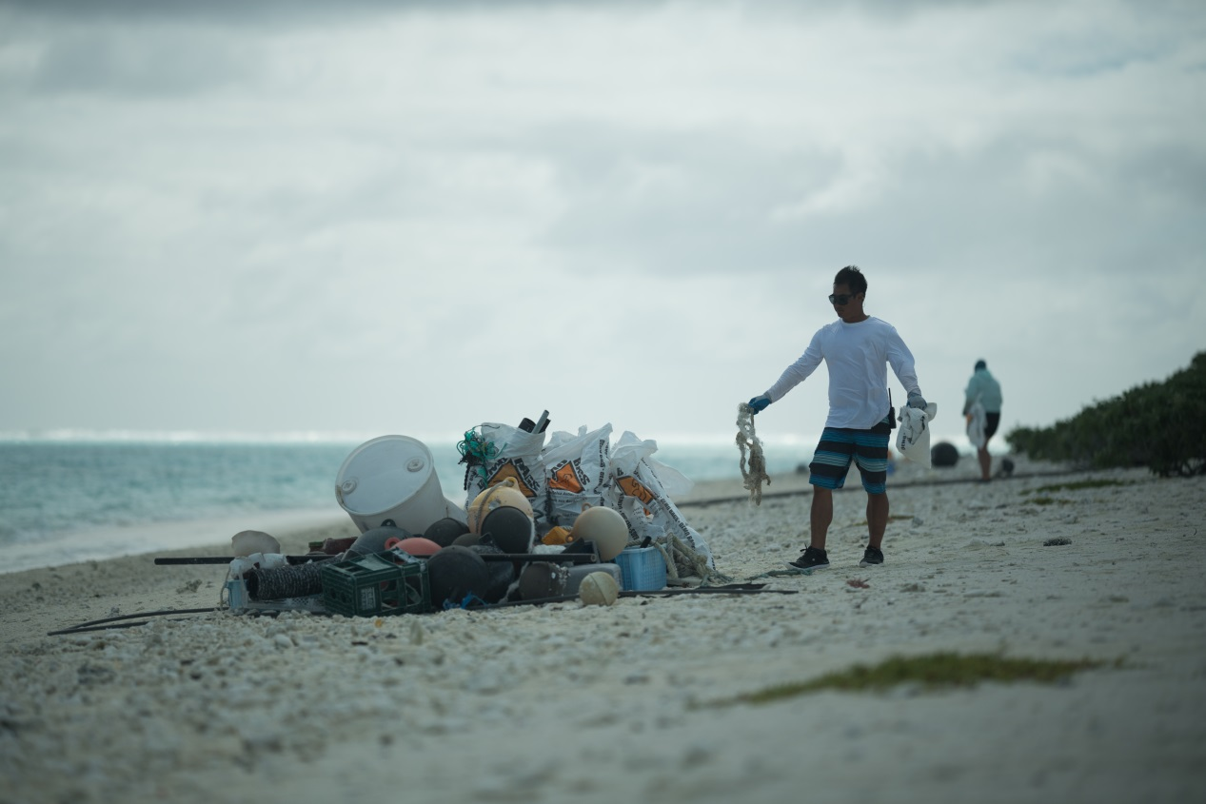
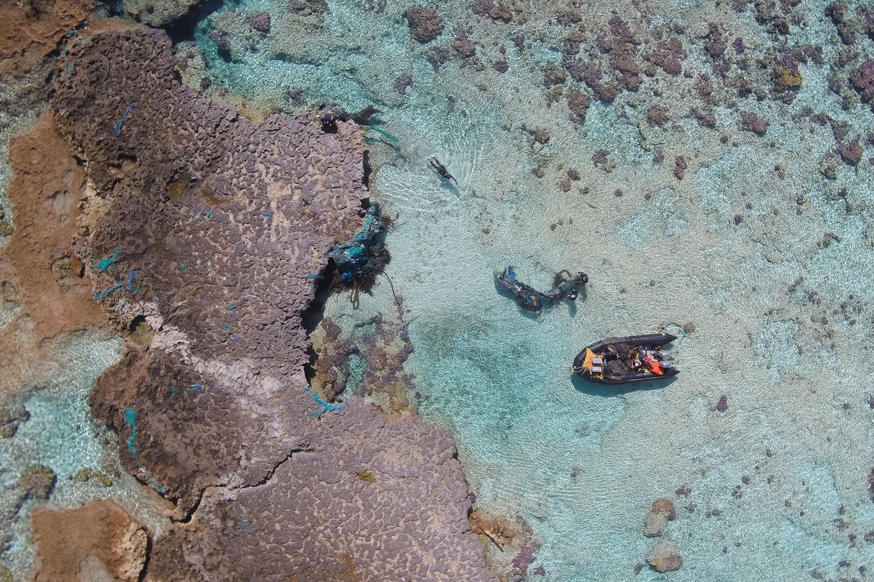

Slide 63
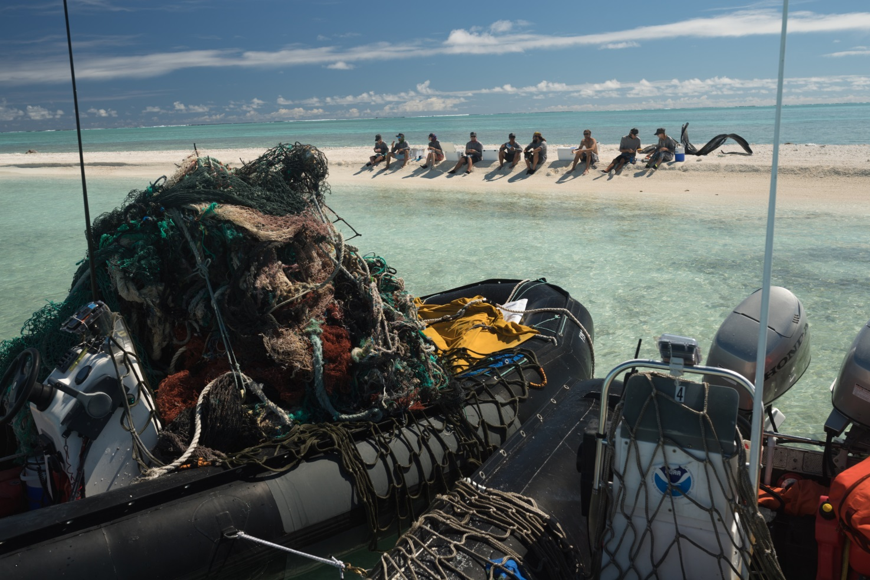
2018 Field Mission – Leg 3 – M/V Imua
October 13-30, 2018
10 staff (9 coxswains + 1 UAS pilot)
Shoreline removal operations
0.18 km² shoreline surveyed and cleaned
49,269 lbs removed

Slide 65
2018 Field Mission – Outreach/Media Event
906 people directly reached through outreach and education
10 elementary/intermediate school outreach events pre-mission
3 high schools attended outreach events post-mission
Information about project shared on blogs, local TV, magazine articles, CBS 60 Minutes

Slide 66
2018 Field Mission – Debris Disposal
Nets-to-Energy Program down-cycles all nets to electricity for Oahu, Hawaii
Clean, usable plastic is used by non-profit organizations and artists for outreach and education
Plastic is donated to a non-profit to recycle and create new products
Remainder is incinerated to create electricity using Waste-to-Energy Program

Slide 67
On-going Research
Shoreline Accumulation Study
Midway Atoll (2013-2018)
Kure Atoll, Pearl and Hermes Atoll, Lisianski Island, Laysan Island, French Frigate Shoals (2018)
Structure-from-Motion (SFM) Benthic Habitat Impact Pilot Study
Satellite Buoy Net Tagging Pilot Study
Unmanned Aerial Systems (UAS) Pilot Study

Slide 68
On-going Research – Shoreline Accumulation
Midway Atoll (2013-2018)
Kure Atoll, Pearl and Hermes Atoll, Lisianski Island, Laysan Island, French Frigate Shoals (2018)

Slide 69
Midway Atoll

Slide 87
On-going Research – Shoreline Accumulation
For every 300m shoreline segment surveyed:
Date of last survey (to calculate # days of accumulation)
Shoreline survey area (m²)
Weight of debris from survey area (lbs)
Tallies of each debris item

Slide 90
On-going Research – SFM Survey
Structure-from-Motion 3-D technology to map the reef
Goal is to quantitatively measure negative impact of net on coral reef ecosystems
Pearl and Hermes Atoll -Lagoon
21 impact site mosaics (before and after net removal)
21 control site mosaics
Analysis and results are pending

Slide 92
Play Sfm video
Play Sfm marine debris video

Slide 96
Recent Research – Satellite Buoy Survey
Paired with SFM study
Goal is to better understand how many reefs a single net impacts before settling
Pearl and Hermes Atoll Lagoon
6 nets tagged
Criteria: >75% buoyant, level 1 (minimal) bio-fouling, minimum 0.5 m³
Analysis and results are pending

Slide 97
Recent Research – UAS Survey
Used Fixed-wing UAS to determine if net detection was feasible
Goal is to reduce in-water survey time and identify net accumulation hot-spots
Pearl and Hermes Atoll Lagoon
60m altitude
Red-green-blue (RGB) and Infrared (IR) sensors
3.39 km² mapped in <10 cm resolution
Mapped areas were ground-truthed via swim survey
Analysis and results are pending

Slide 101
Future
2020 is a data analysis year
Analyze shoreline accumulation data
Sfm: Compare net size/weight (lbs) to impact area (m²)
UAS net detection assessment
2021 is next projected field mission
Large-scale removal mission (30-60 days)
Resurvey impact and control sites for successional change in benthic habitat composition

Slide 102
For more information on the project
Visit www.marinedebris.noaa.gov
Visit www.fisheries.noaa.gov/pacific-islands/marine-debris-research-and-removal-northwestern-hawaiian-islands
Visit https://marinesanctuary.org/blog/video-spotlighting-the-threat-marine-debris-poses-to-wildlife-in-papahanaumokuakea/
Email: james.morioka@noaa.gov
Office Phone: (808) 725-5491
Mailing Address: NOAA IRC
Attn: James Morioka, PIFSC/ESD
1845 Wasp Blvd., Bldg. #176
Honolulu, HI 96818

Slide 103
Questions?

